Slide 1
Functions, Organization, Arrays, Vectors, Lists and some comparison
Unit-01

Slide 2
Functions
Unit-01.1

Slide 3
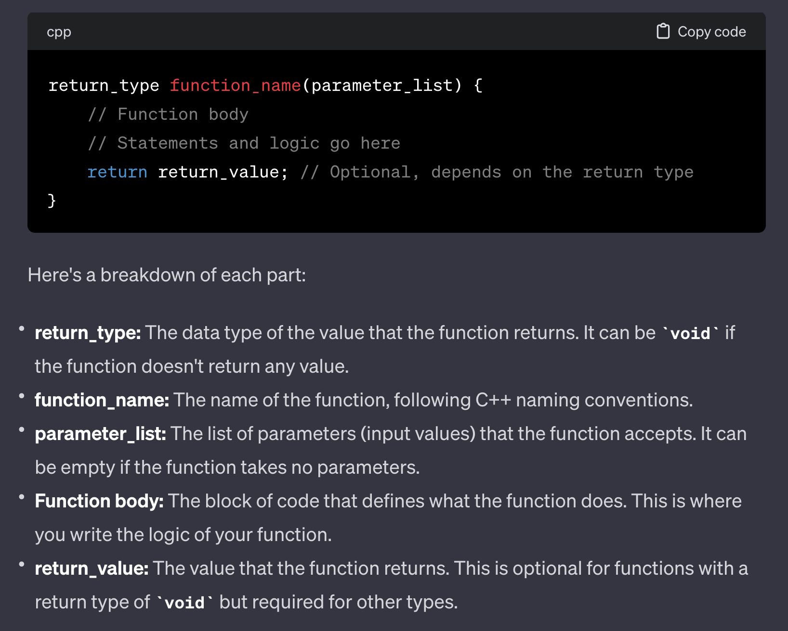

Slide 4
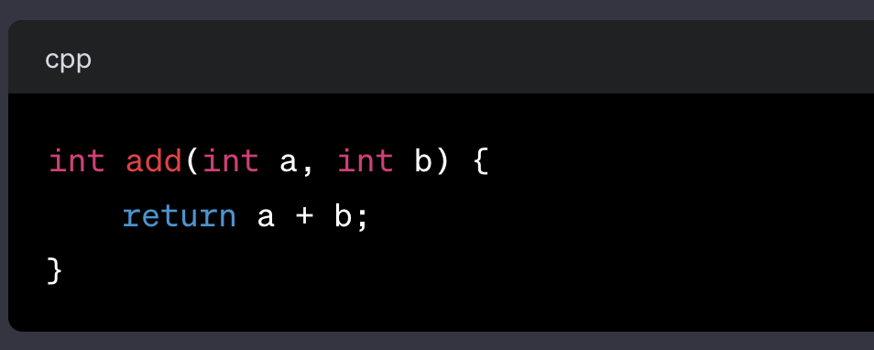
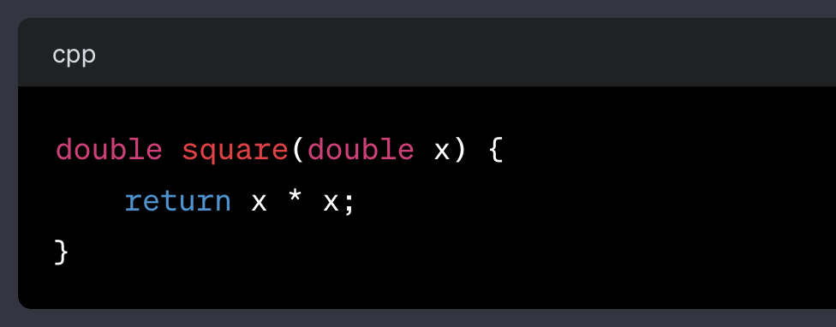
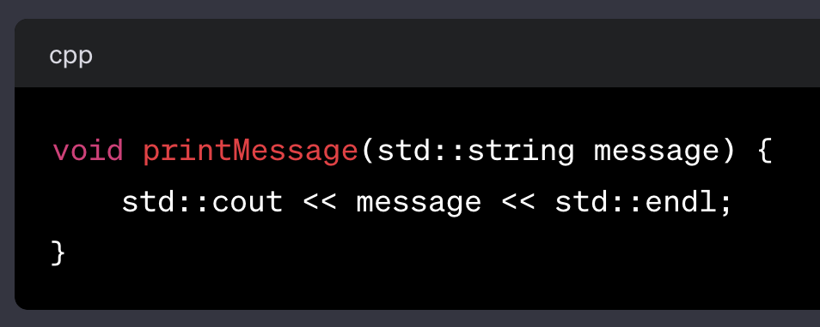
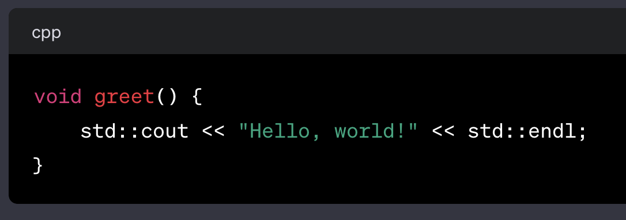
1. Function with arguments no return type 2. Function with arguments with return type 3. Function without arguments with return type 4. Function without arguments without return type
[A]
[D]
[B]
SUMMARY
[C]

Slide 5
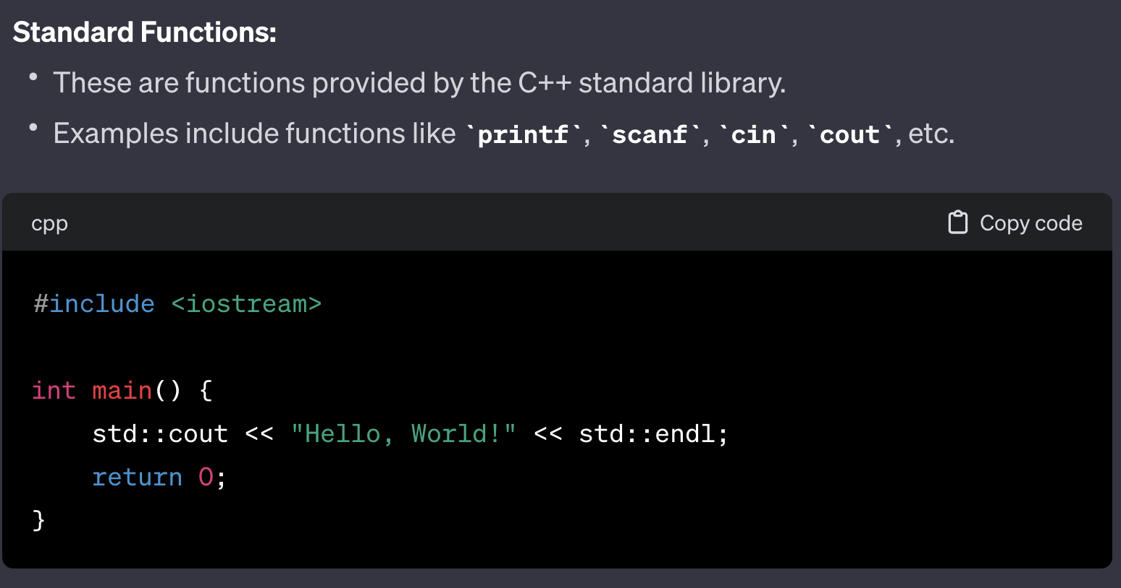
VARIOUS TYPES OF FUNCTIONS
1. Standard Functions (std)

Slide 6
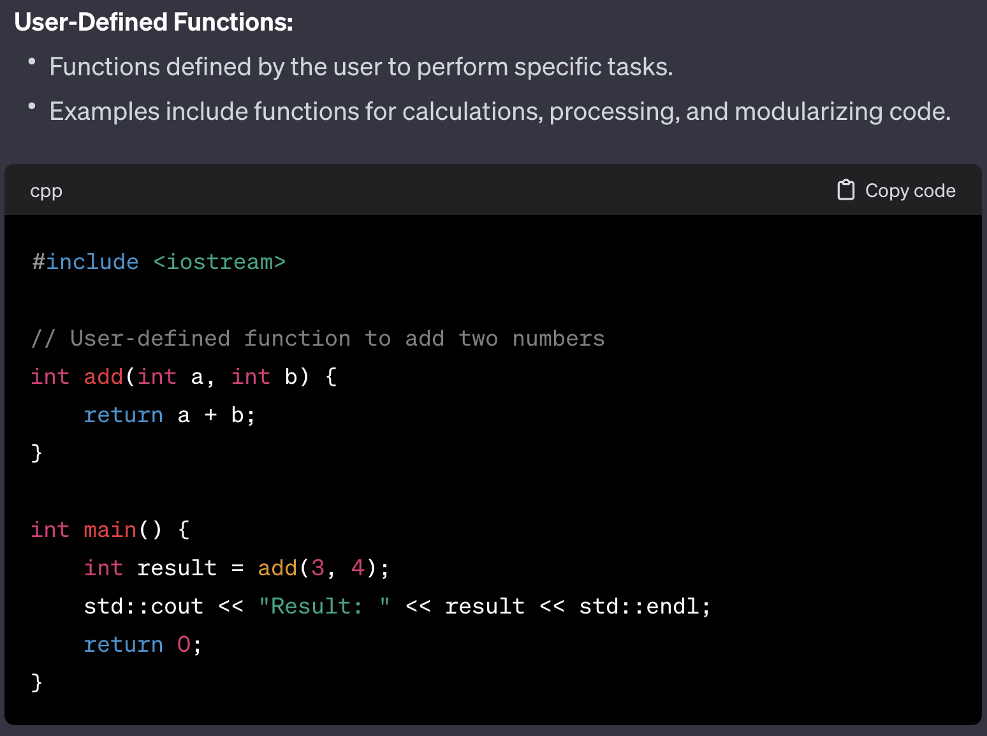
VARIOUS TYPES OF FUNCTIONS
2. User Defined Functions

Slide 7
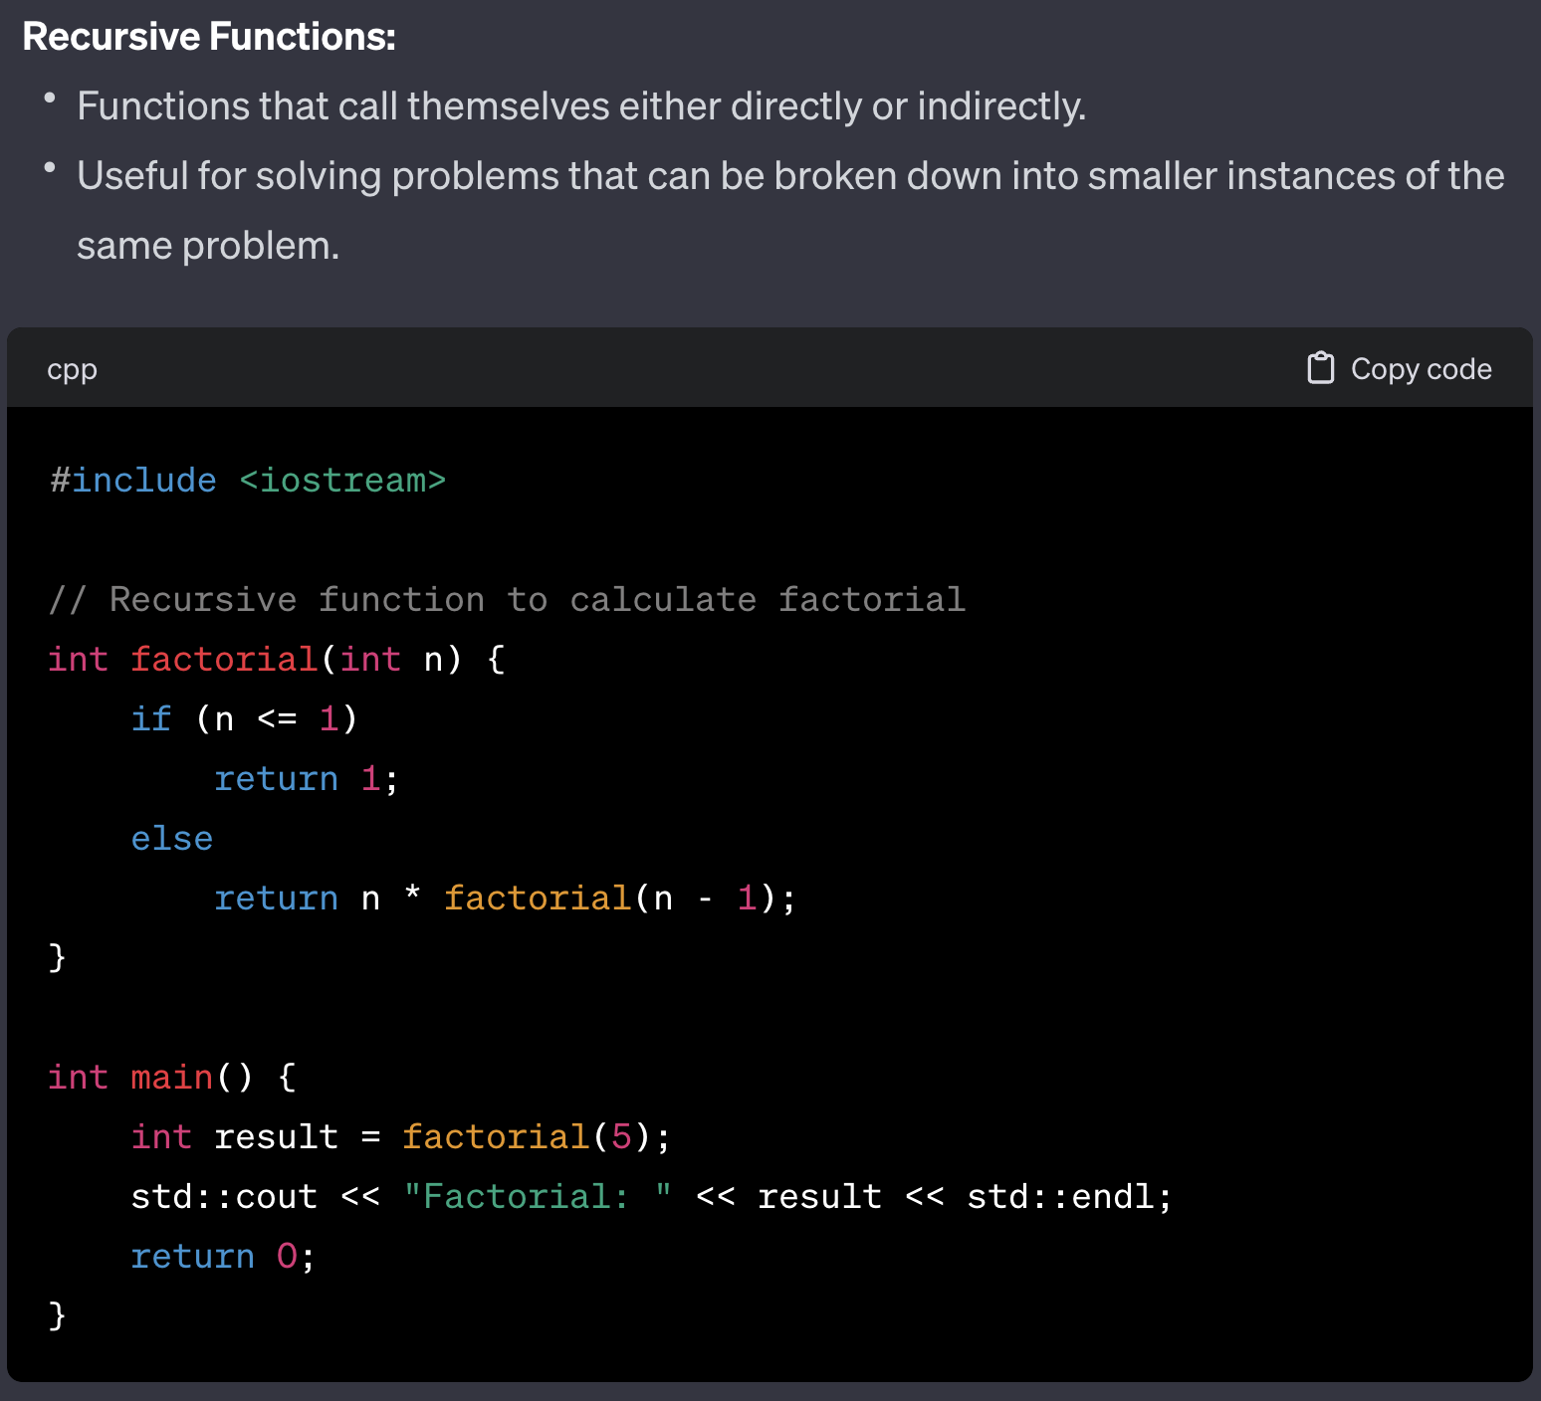
VARIOUS TYPES OF FUNCTIONS
3. Recursive Functions

Slide 8
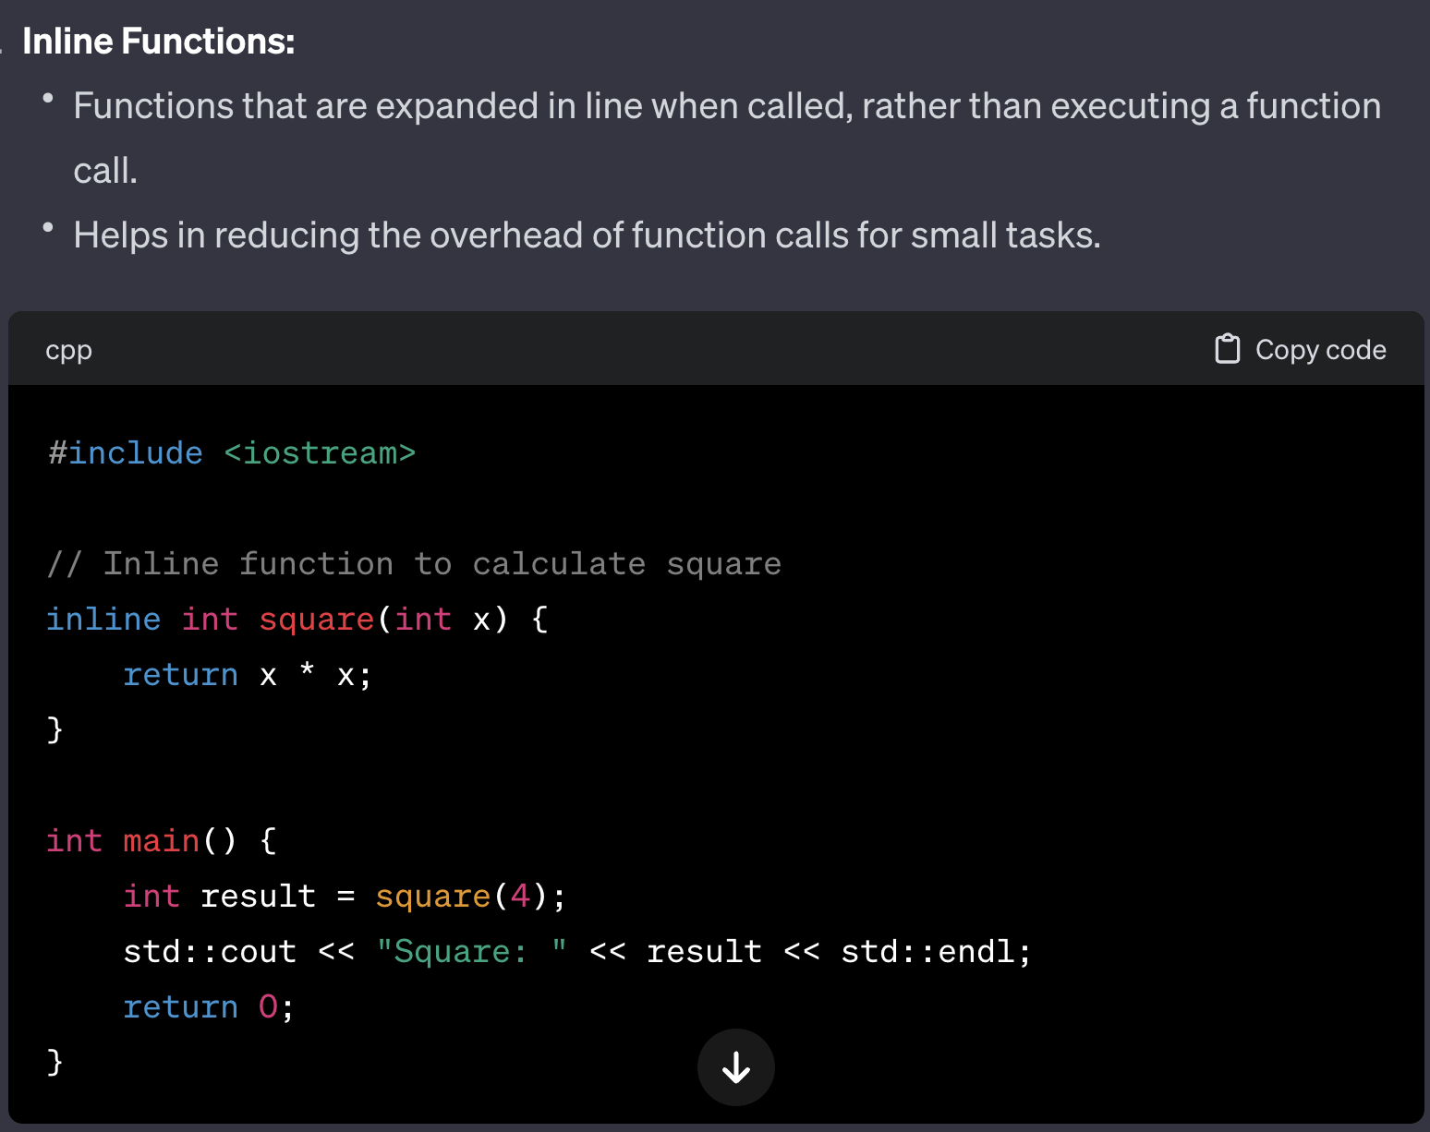
VARIOUS TYPES OF FUNCTIONS
4. Inline Functions

Slide 9
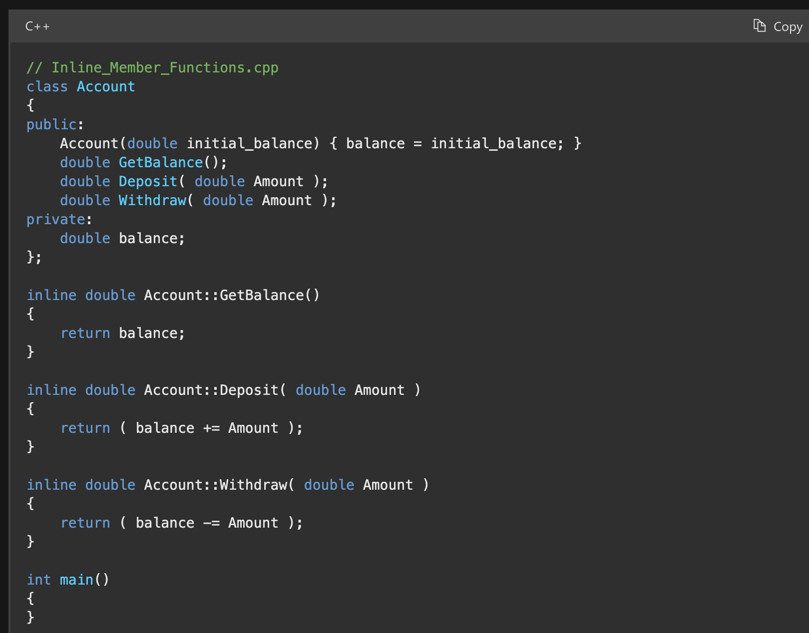
VARIOUS TYPES OF FUNCTIONS
4. Inline Functions…
In the following class declaration, the Account constructor is an inline function because it is defined in the body of the class declaration. The member functions GetBalance, Deposit, and Withdraw are specified inline in their definitions. The inline keyword is optional in the function declarations in the class declaration.

Slide 10
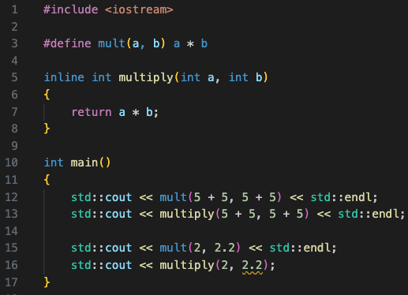
VARIOUS TYPES OF FUNCTIONS
4. Macro..
Can you guess the output from
- L12
- L13
-L15
-L16

Slide 11
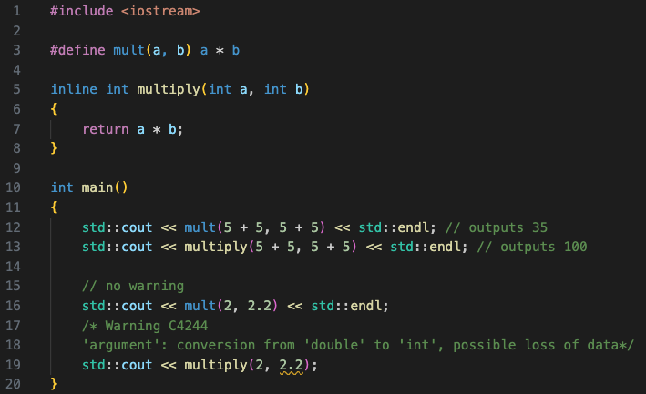
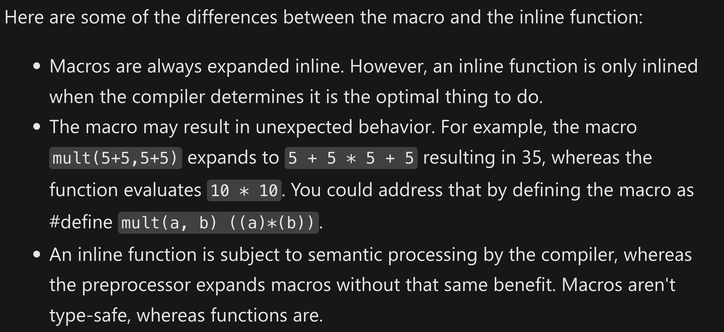
VARIOUS TYPES OF FUNCTIONS
4. Inline Functions vs Macros

Slide 12
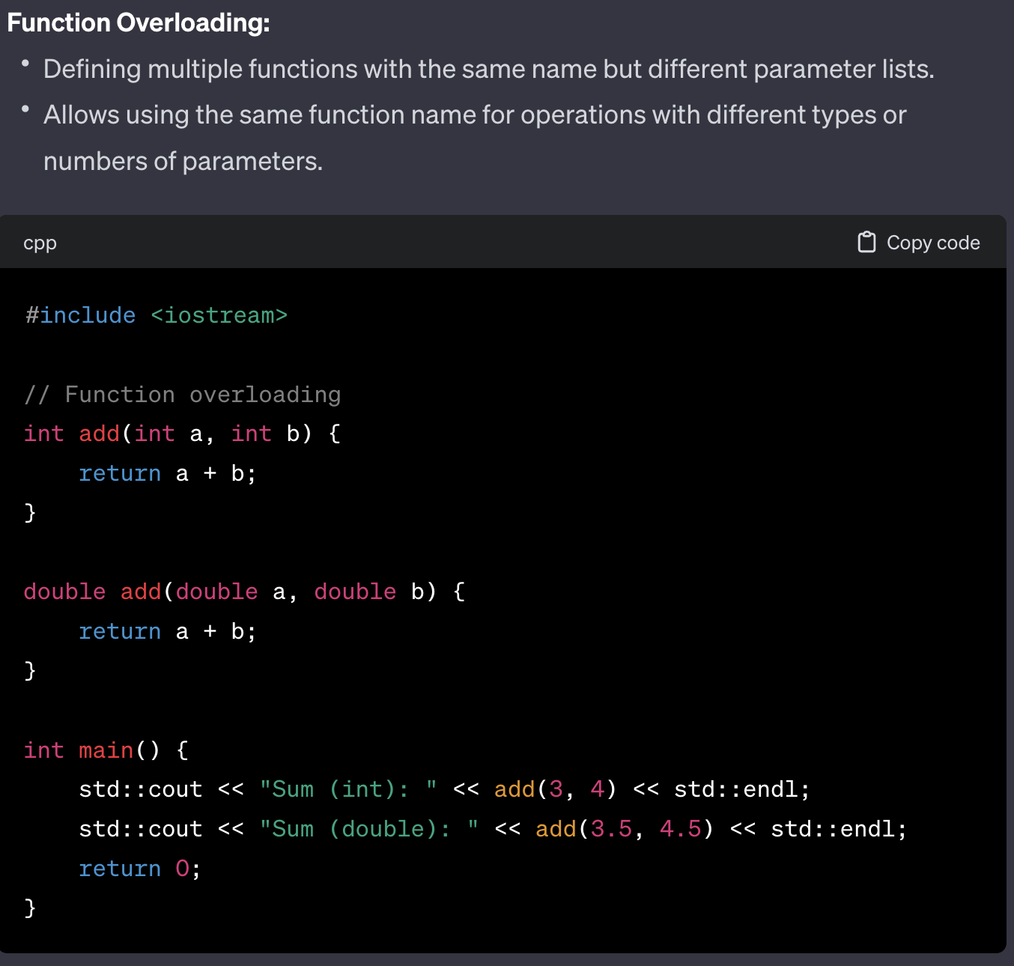
VARIOUS TYPES OF FUNCTIONS
4. Function Overloading

Slide 13
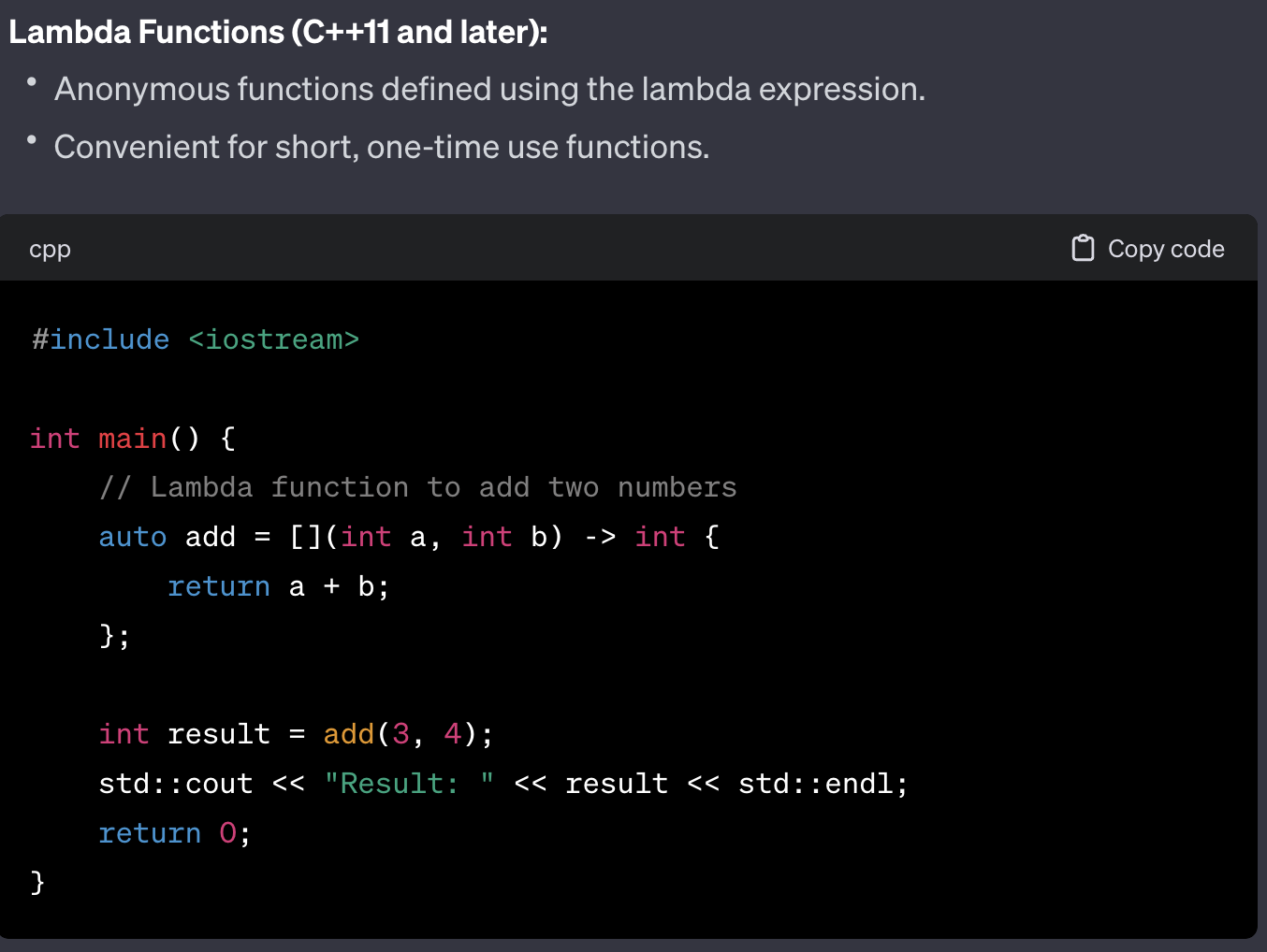
VARIOUS TYPES OF FUNCTIONS
4. Lambda Functions (>=C++11)

Slide 14
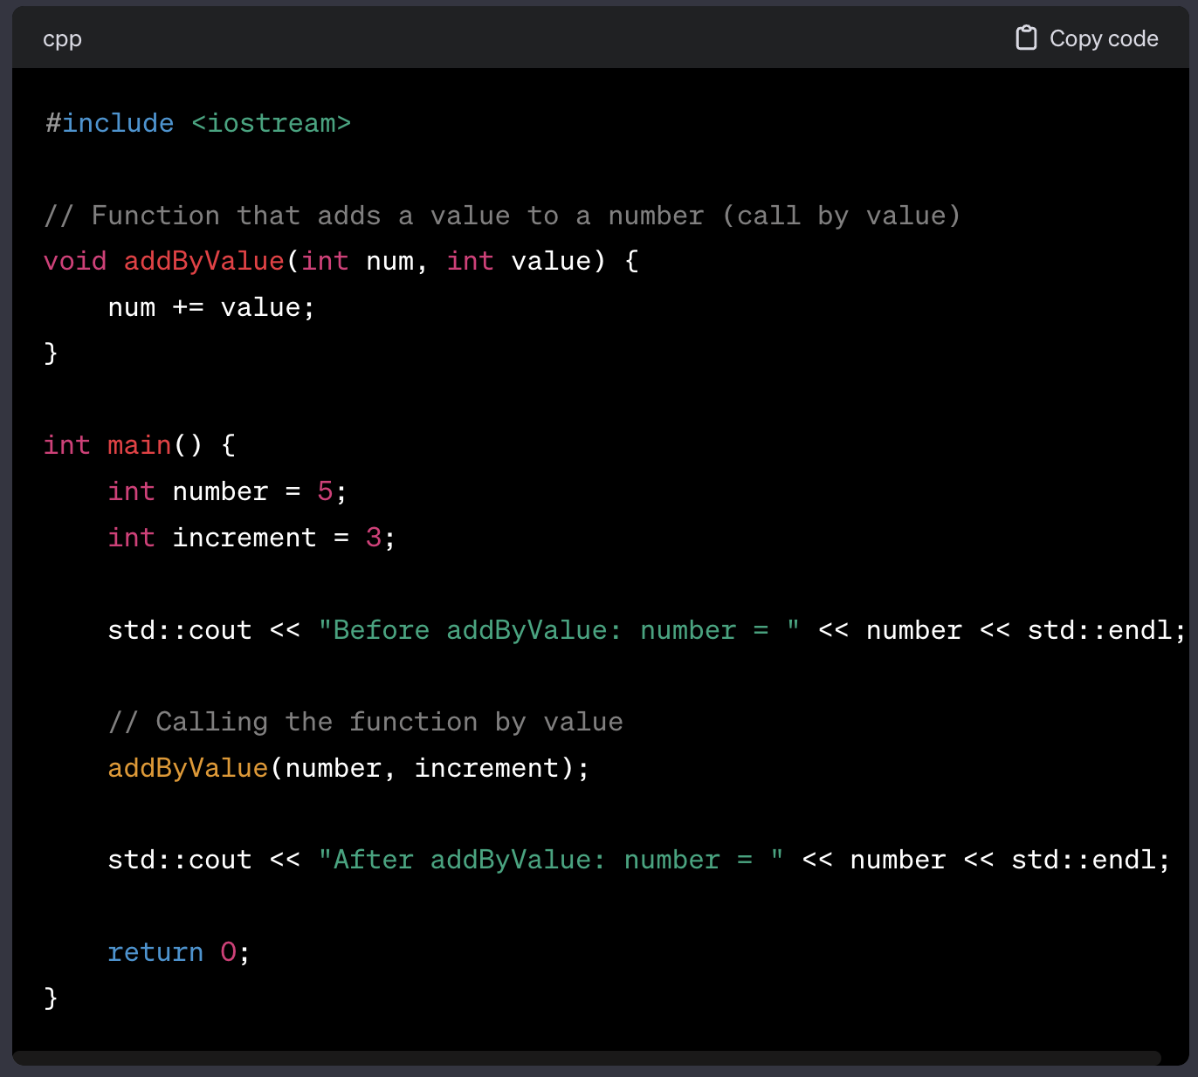
FUNCTION CALL
Call by Value
The function call has NO
effect on number inside main function
i.e., number is still 5

Slide 15
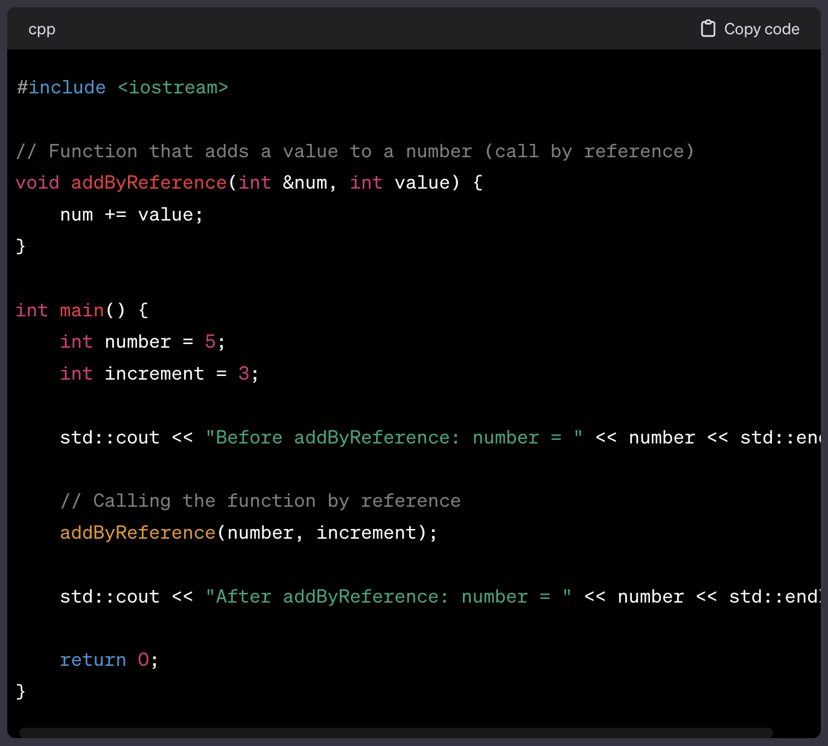
FUNCTION CALL
Call by Value
The function call has
effect on number inside main function
i.e., number will be 8

Slide 16
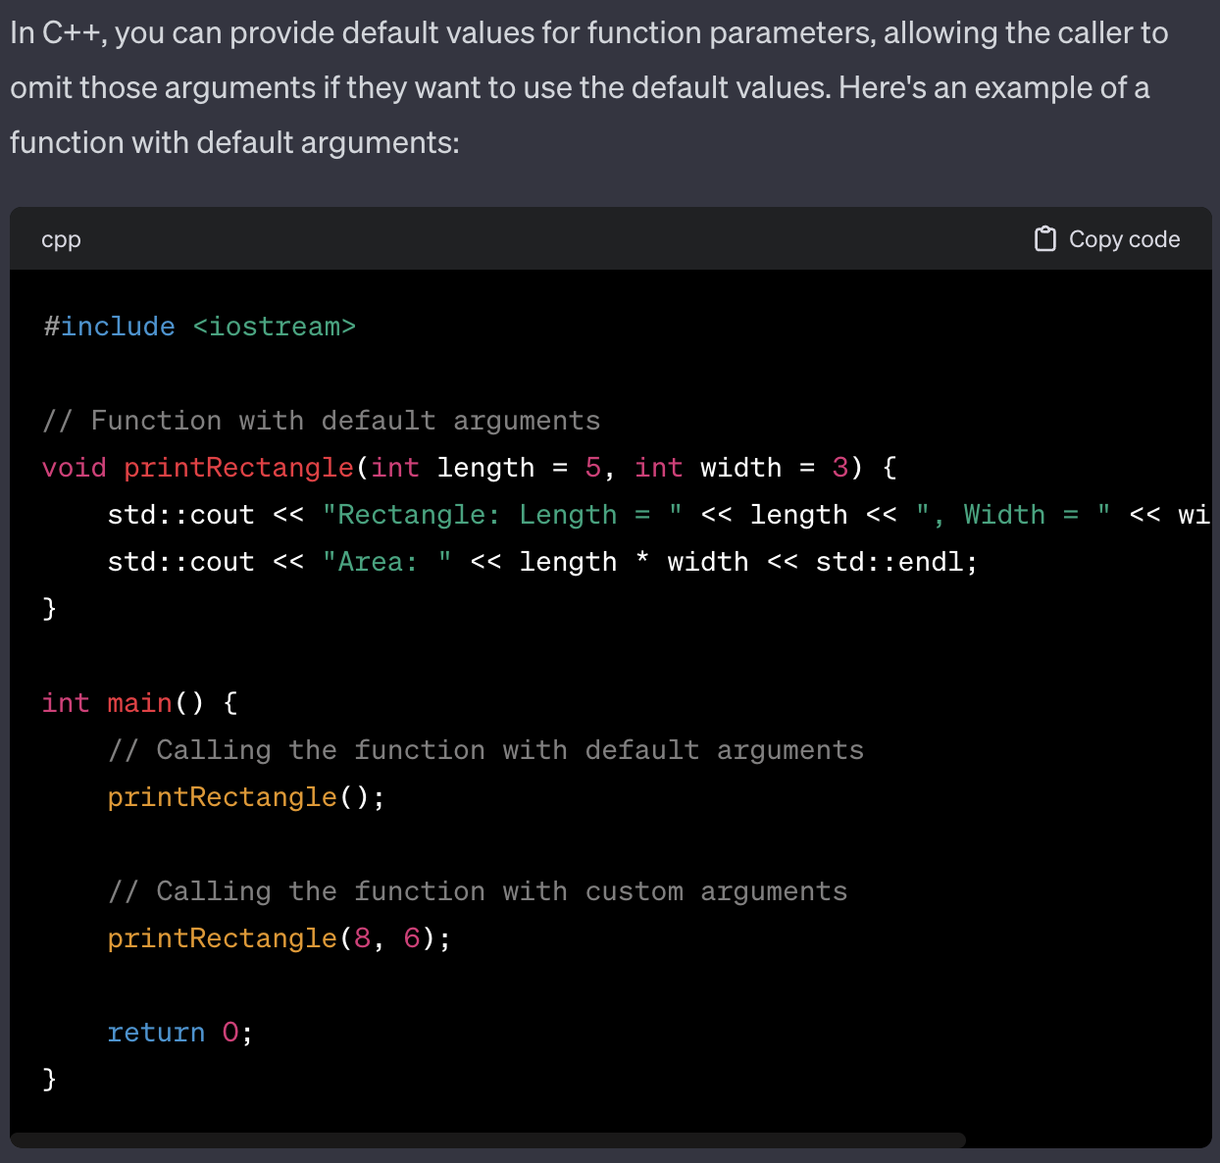
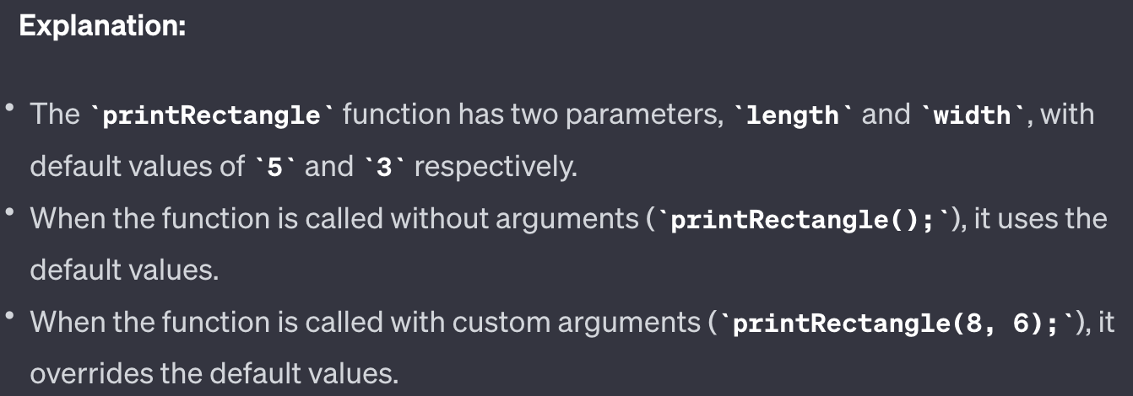
FUNCTION ARGS
Default

Slide 17
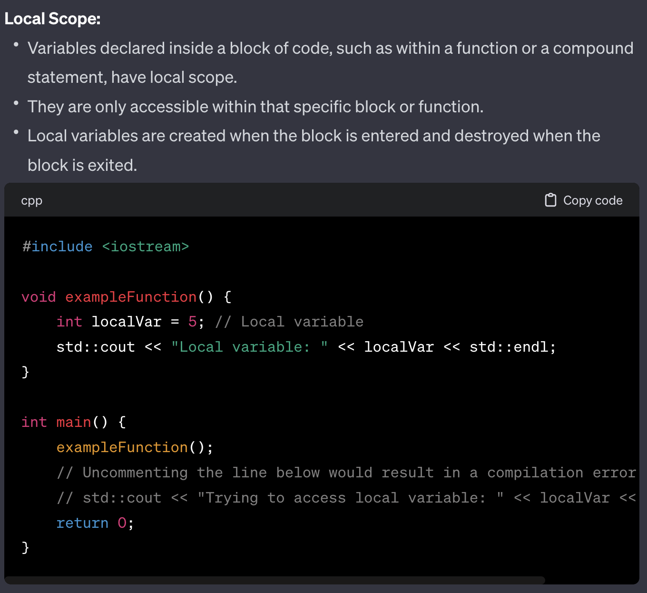
VARIABLE SCOPE
Local

Slide 18
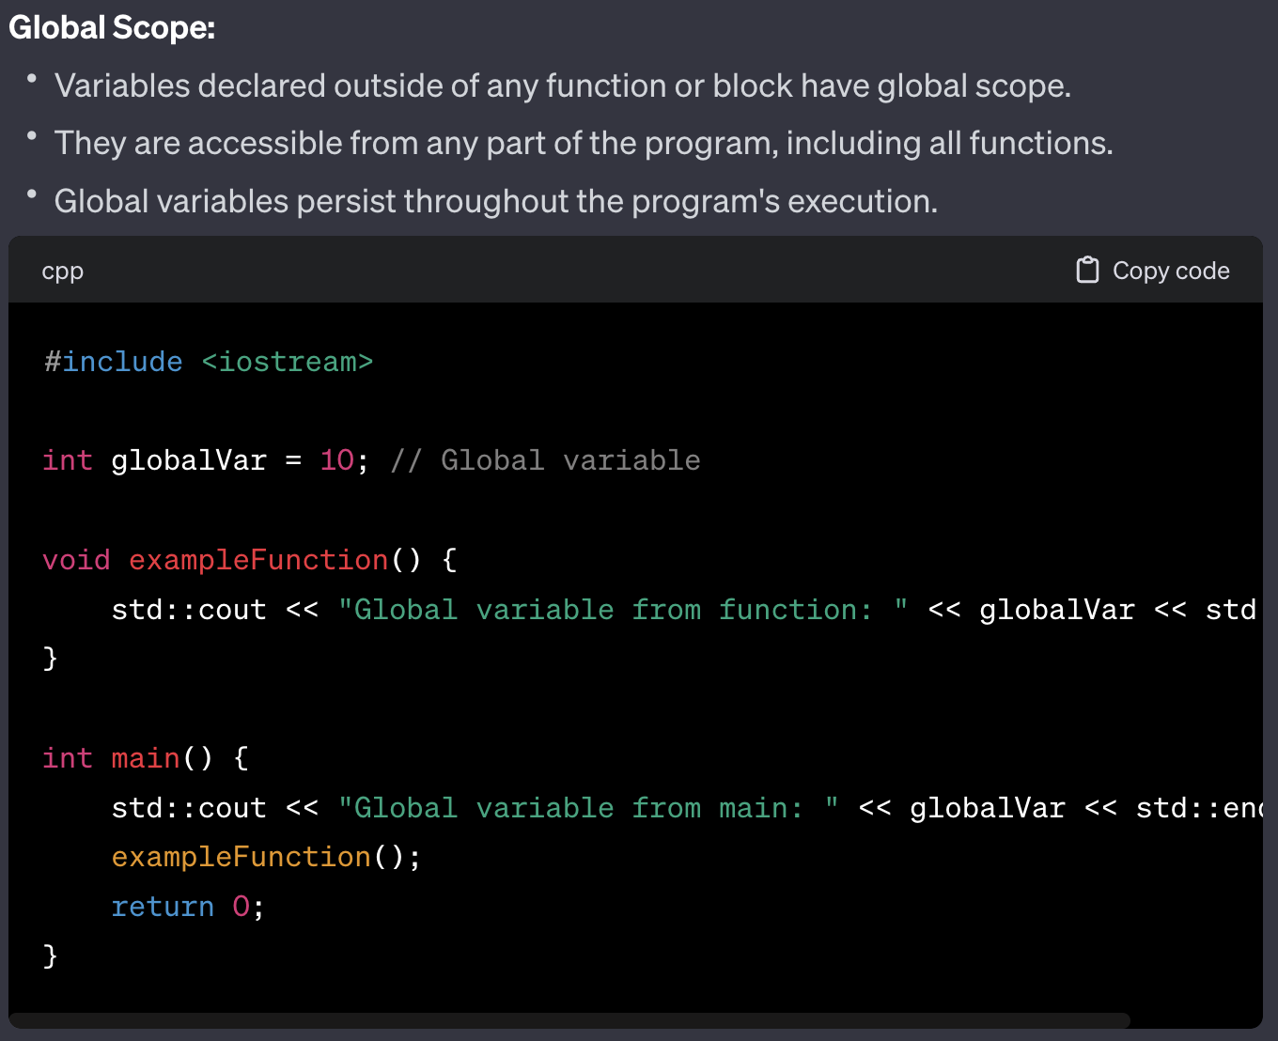
VARIABLE SCOPE
Global

Slide 19
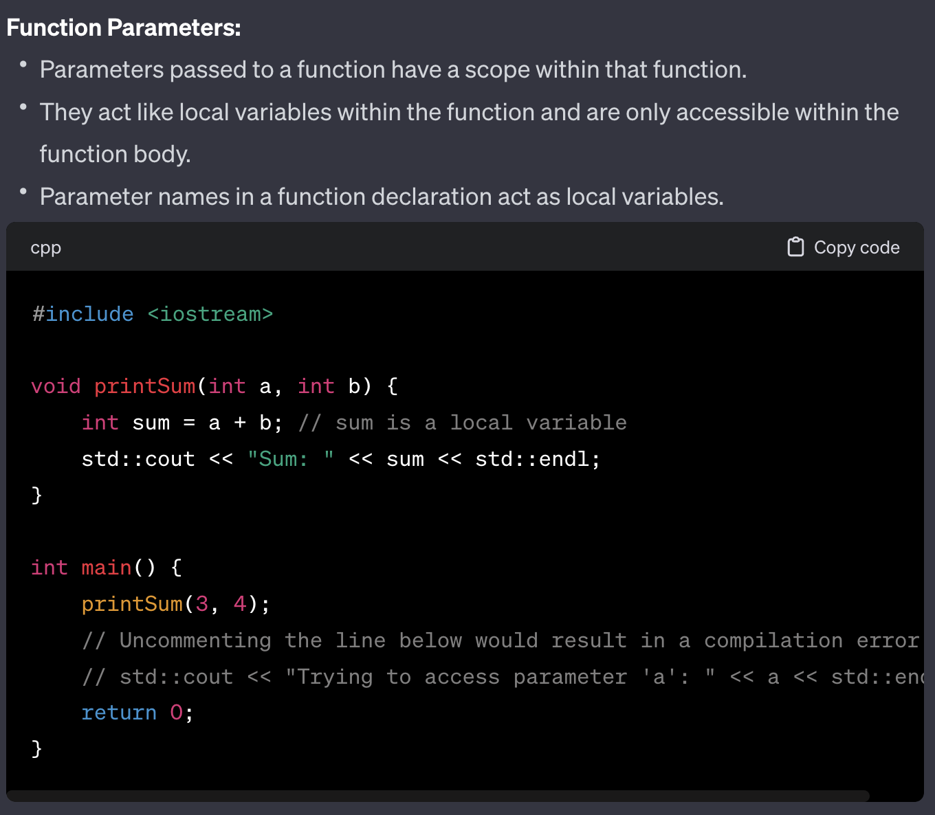
VARIABLE SCOPE
Parameters

Slide 20
Organization
Unit-01.2

Slide 21
As your project gets bigger and bigger, it is impossible to put everything in one big file.
WHY?

Slide 22
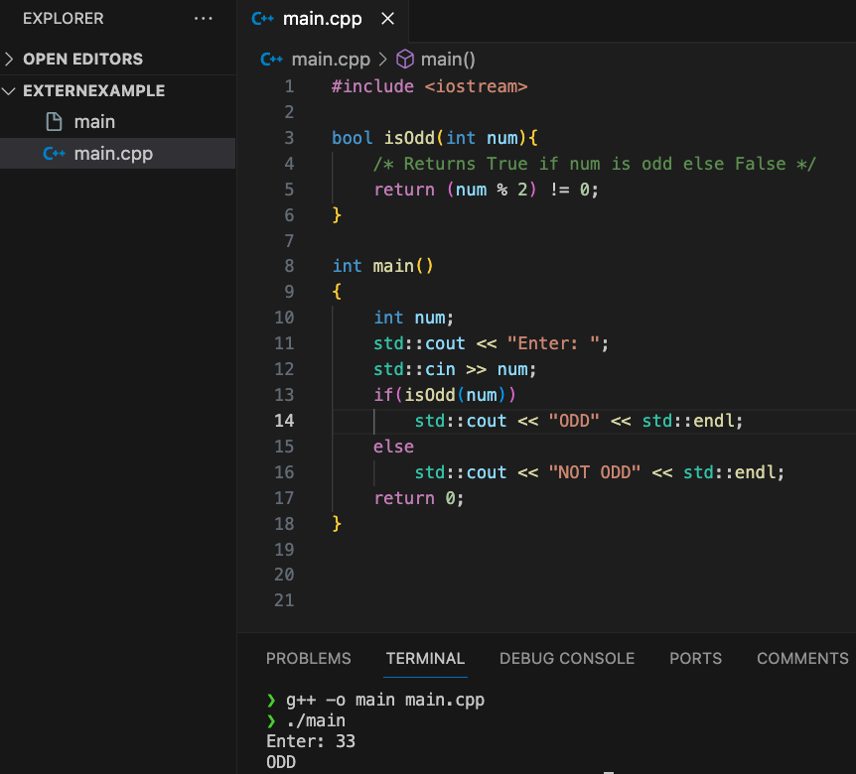
Organization
Simple easy: good for small projects
CASE1: Everything in one file, function first and main

Slide 23
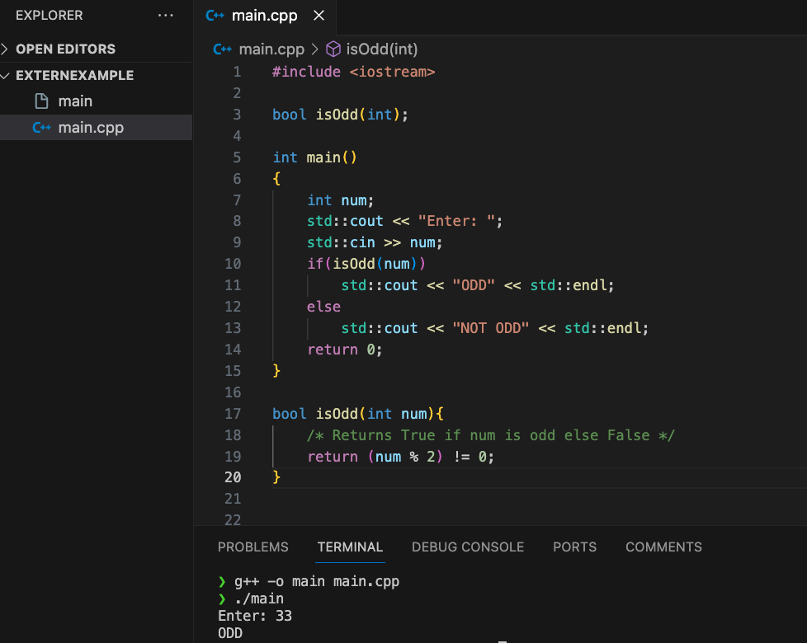
Organization
Simple easy: good for small projects
CASE1: Everything in one file, with function declaration

Slide 24
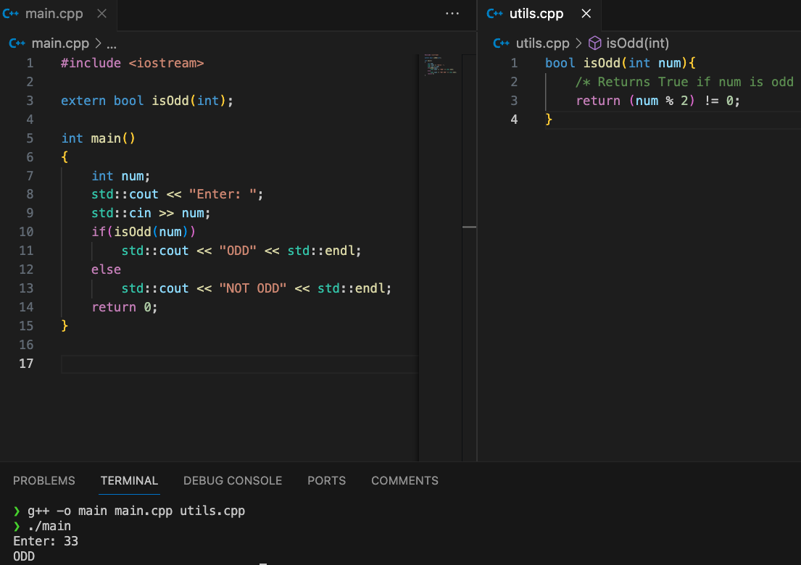
Organization
Your project is now a big deal!!
CASE2: USING External Function from different file

Slide 25
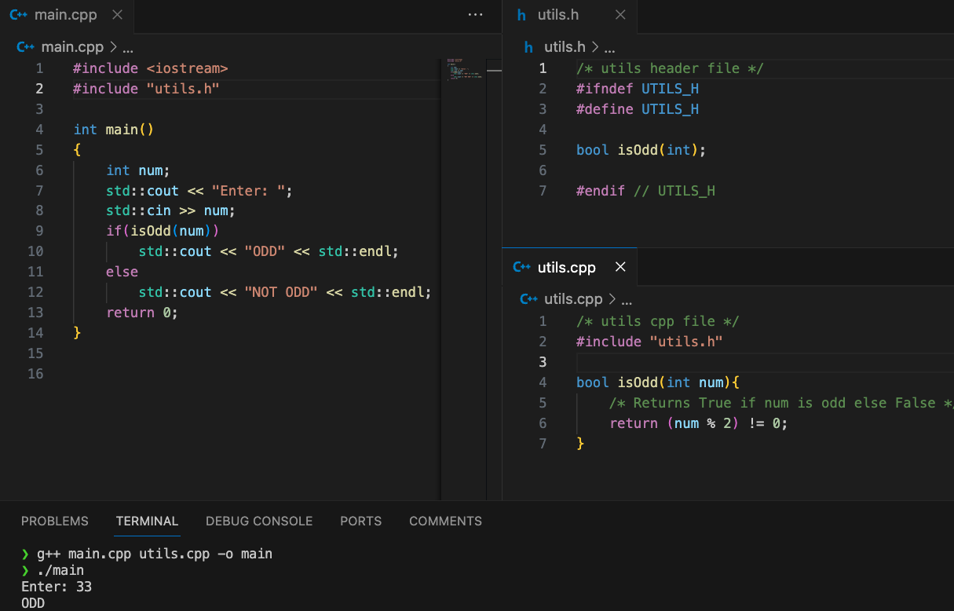
Organization
Your project is now a big deal!!
CASE2: USING Header Files

Slide 26
Organization
BUT WHY?
BUT WHY?

Slide 27
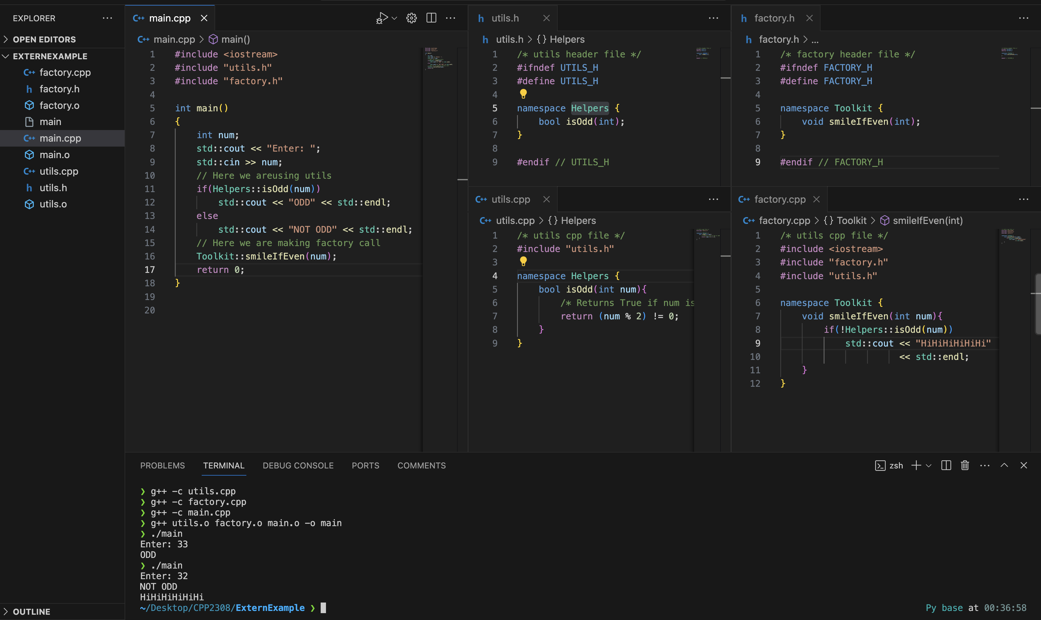
Organization
Case Study

Slide 28
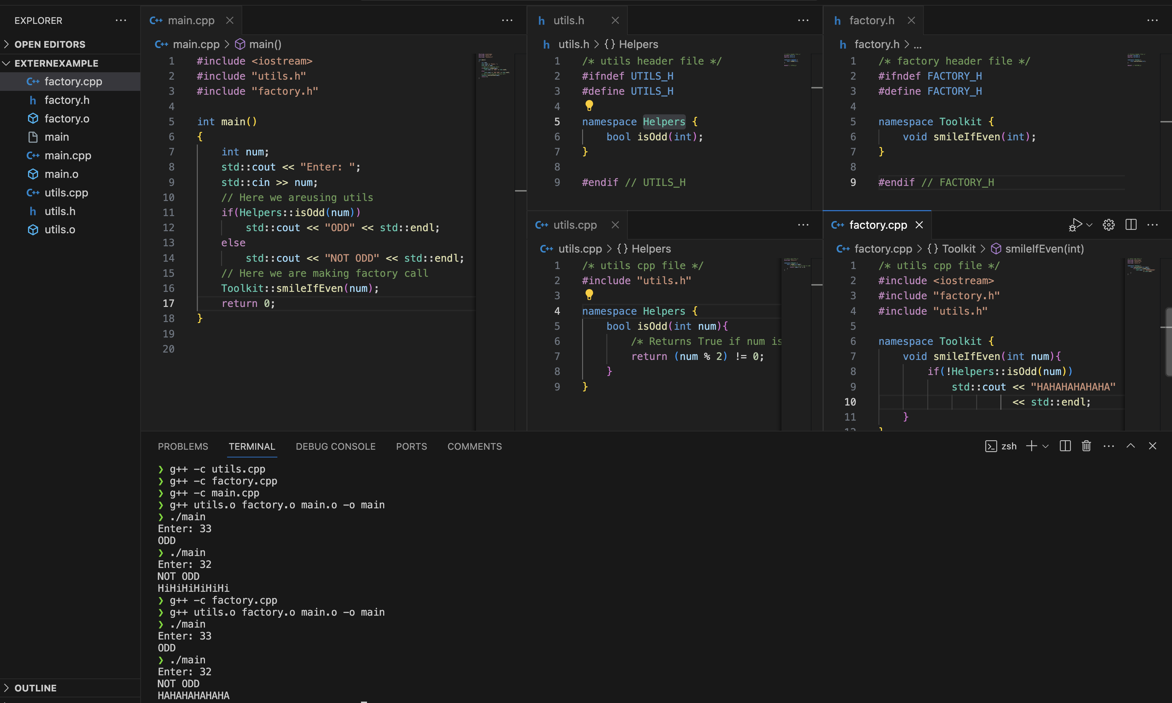
Organization
Having multiple files, work independently, compile only that changes

Slide 29
Arrays
Unit-01.3

Slide 30
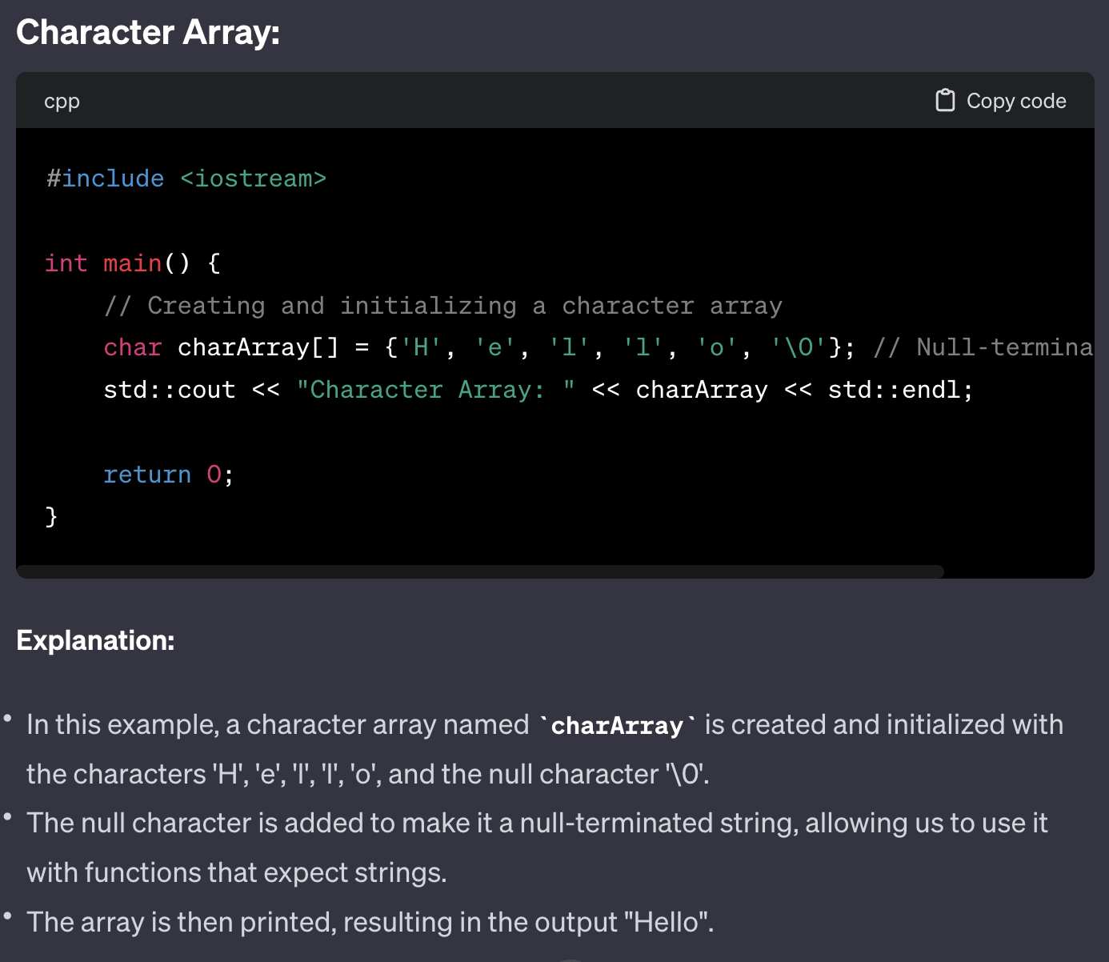
ARRAY
Char Array

Slide 31
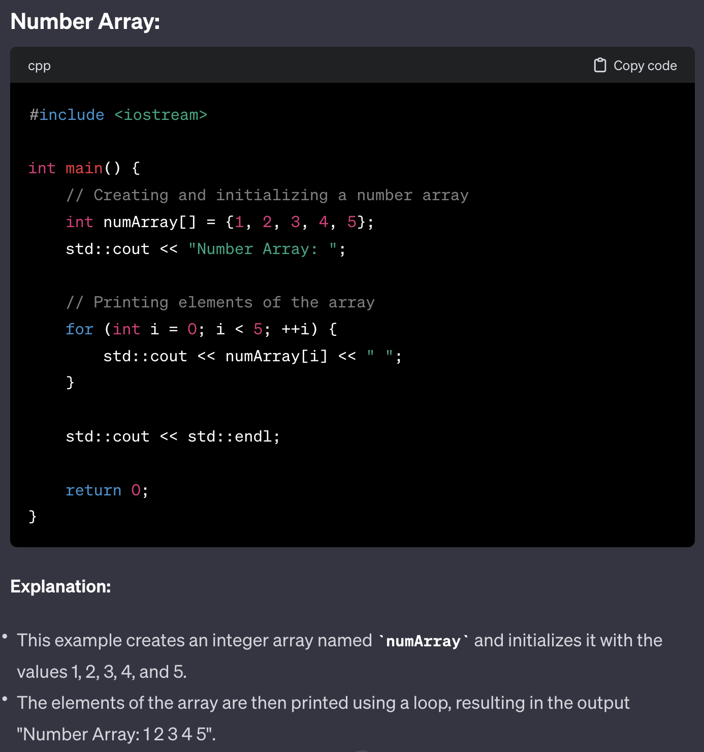
ARRAY
Number Array

Slide 32
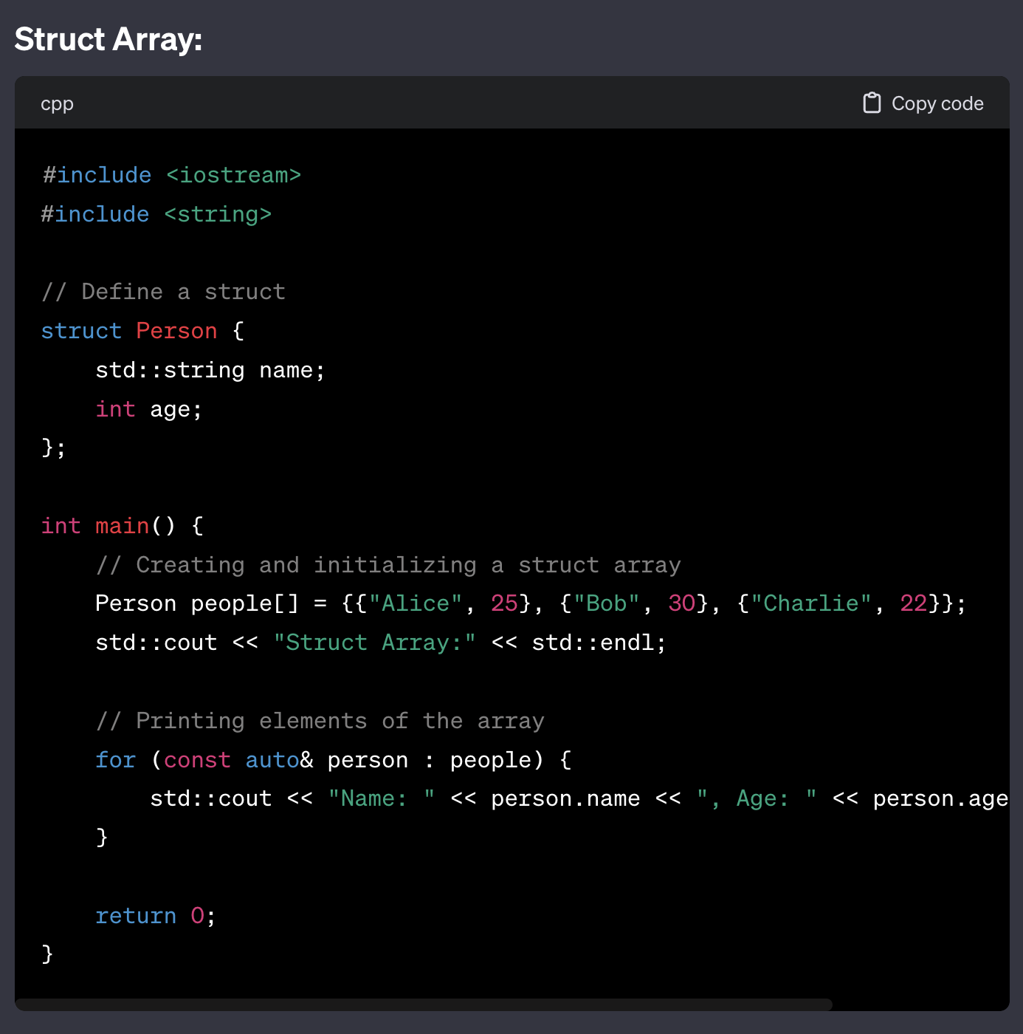
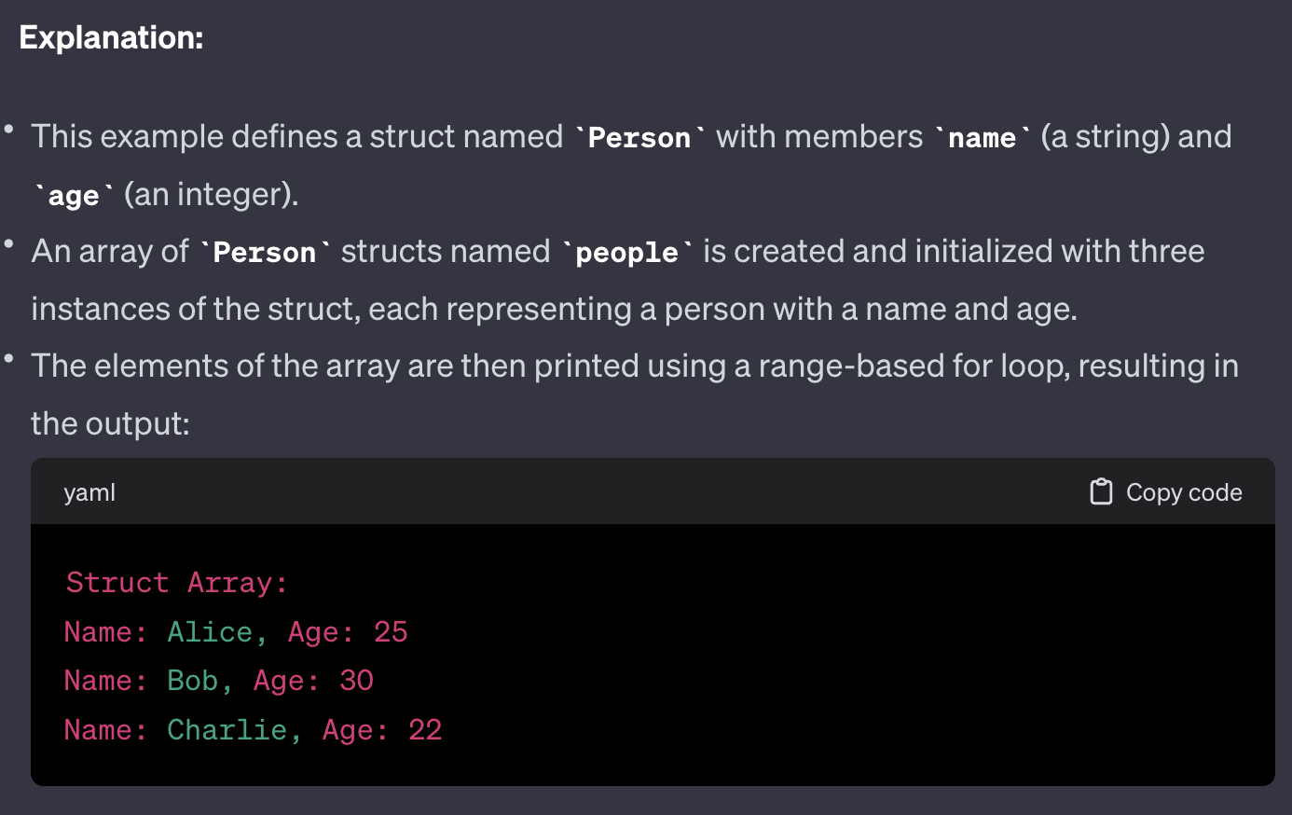
ARRAY
Struct Array
PLEASE IGNORE THIS FOR LOOP FOR NOW
<< std::endl;

Slide 33
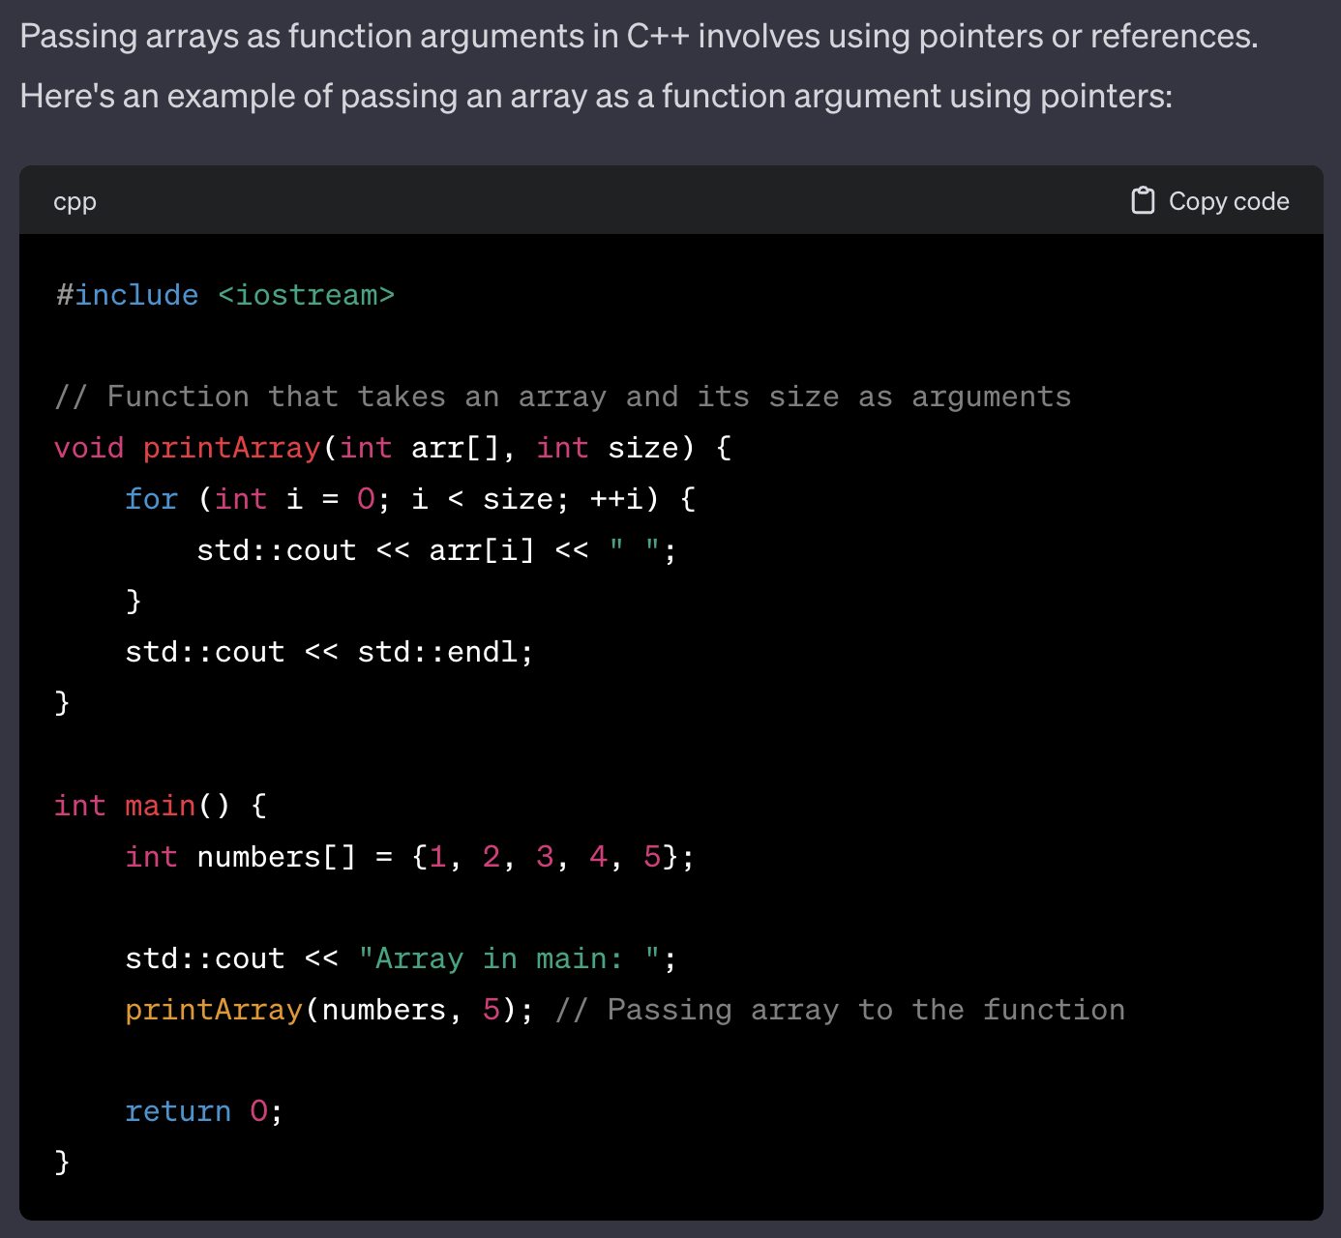
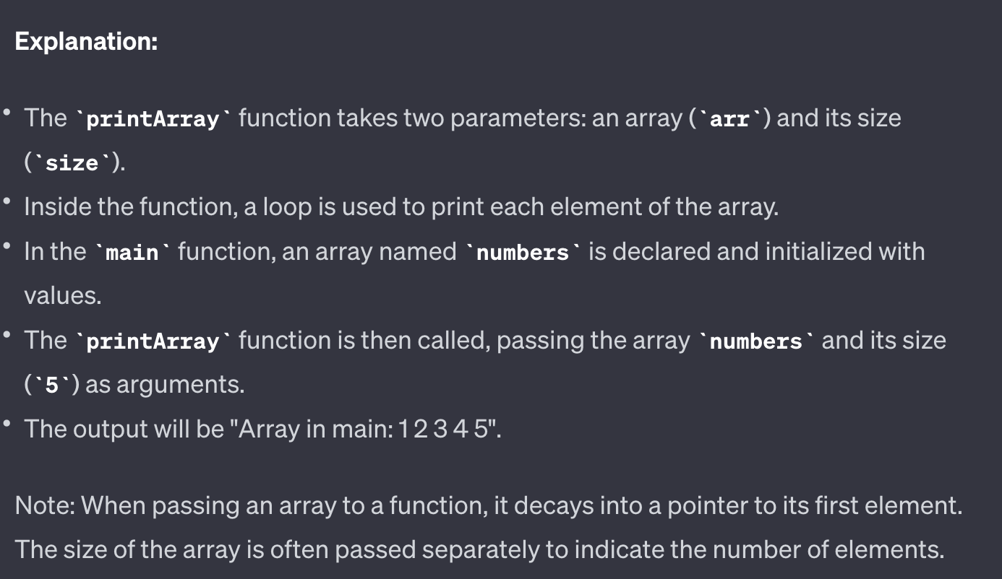
ARRAY
As function argument

Slide 34
ARRAY
As function argument
WHAT HAPPENS IF YOU MODIFY ARRAY INSIDE FUNCTION?

Slide 35
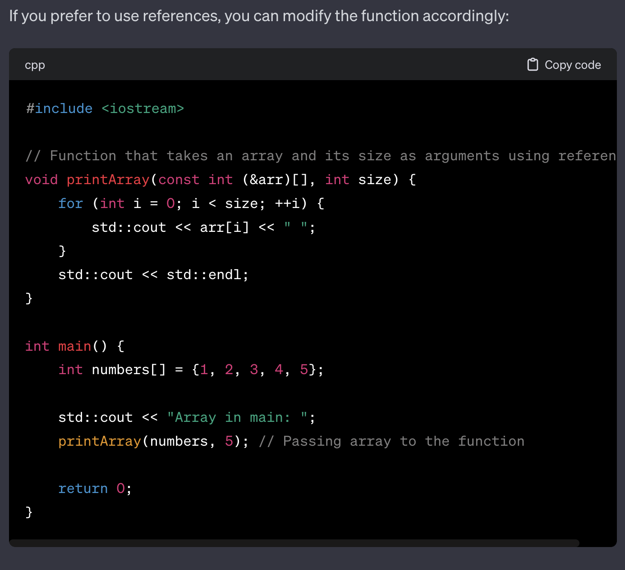
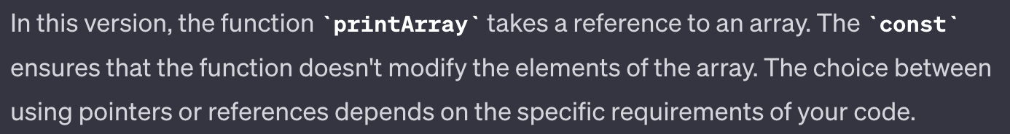
ARRAY
You can also pass ref.

Slide 36
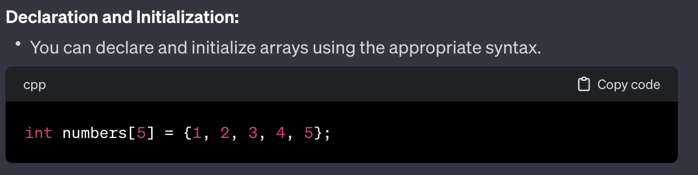
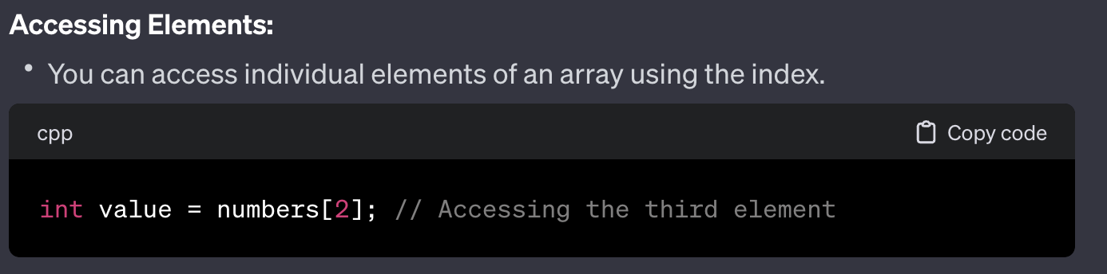
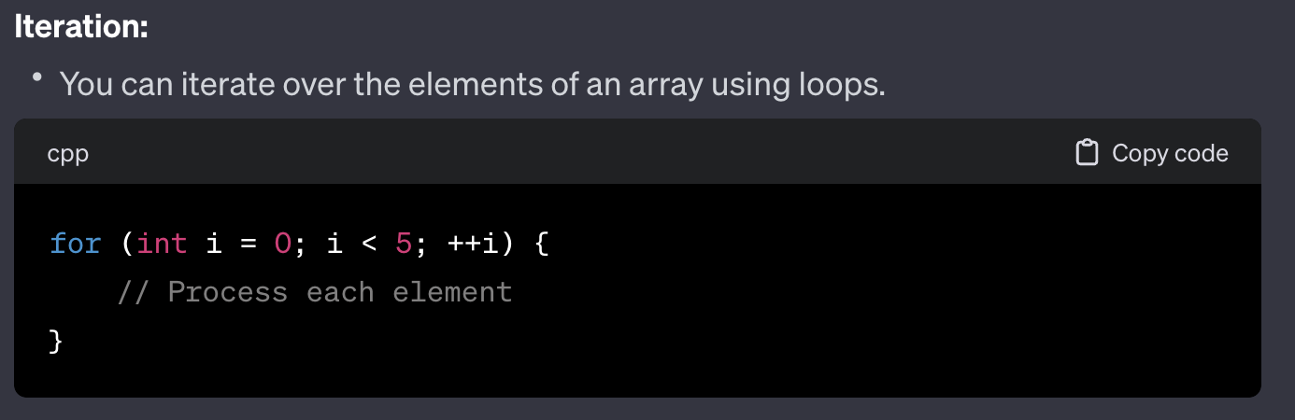
ARRAY
WHAT IS ALLOWED?

Slide 37
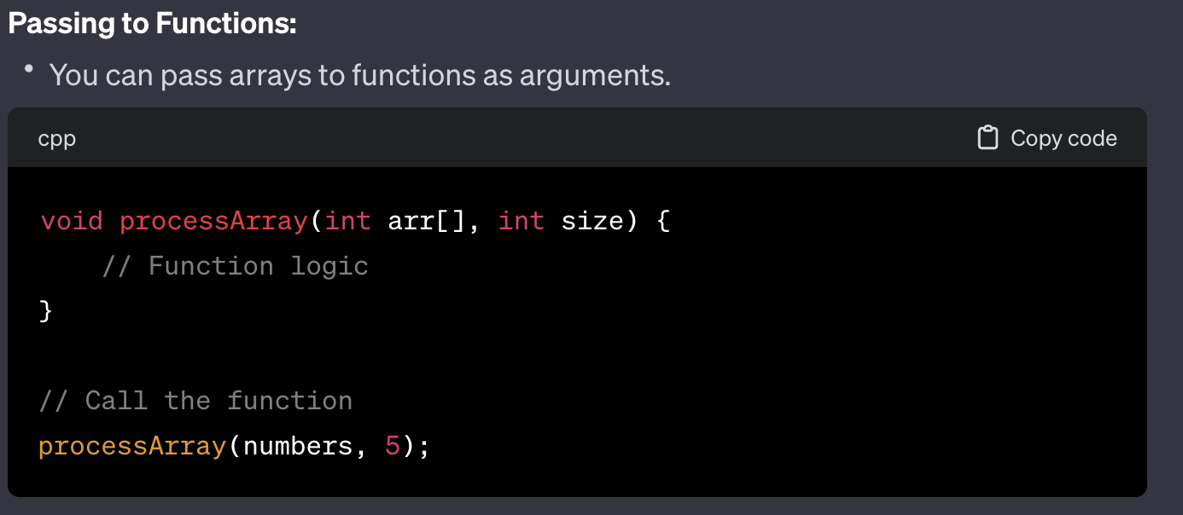
ARRAY
WHAT IS ALLOWED?

Slide 38
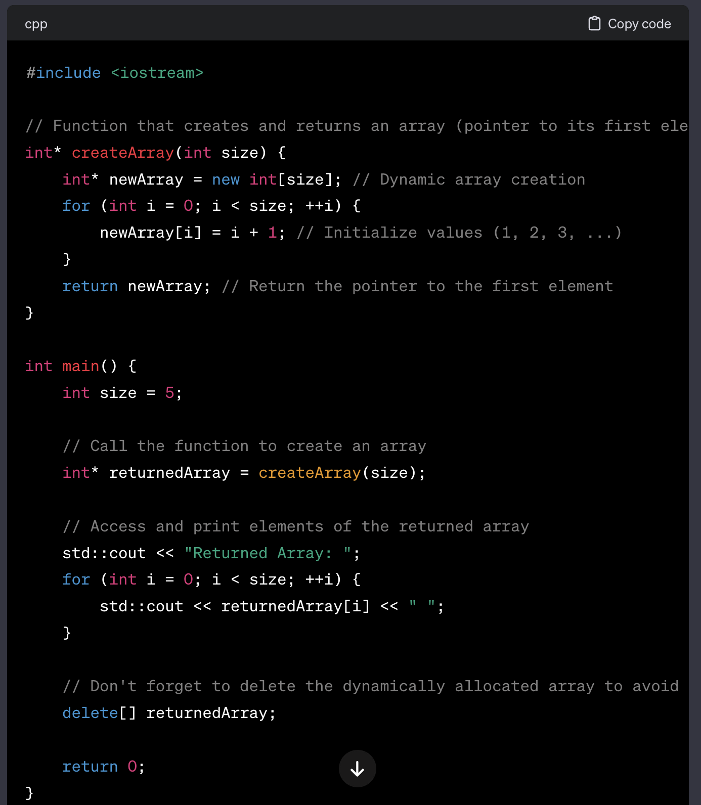
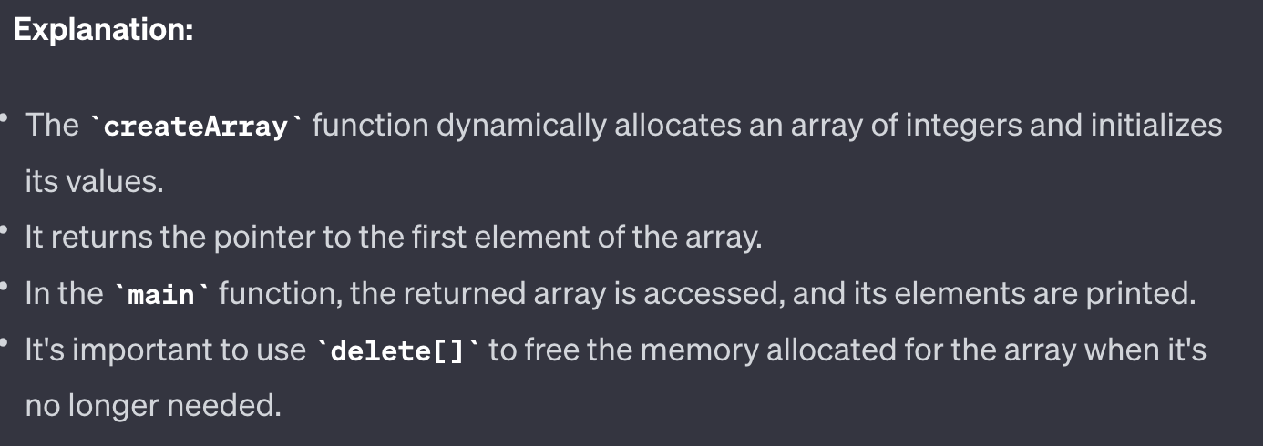
ARRAY
WHAT IS ALLOWED?

Slide 39
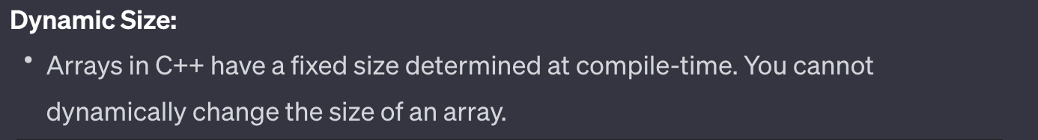
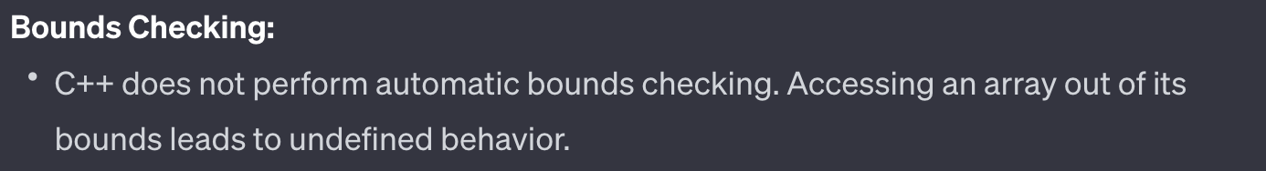
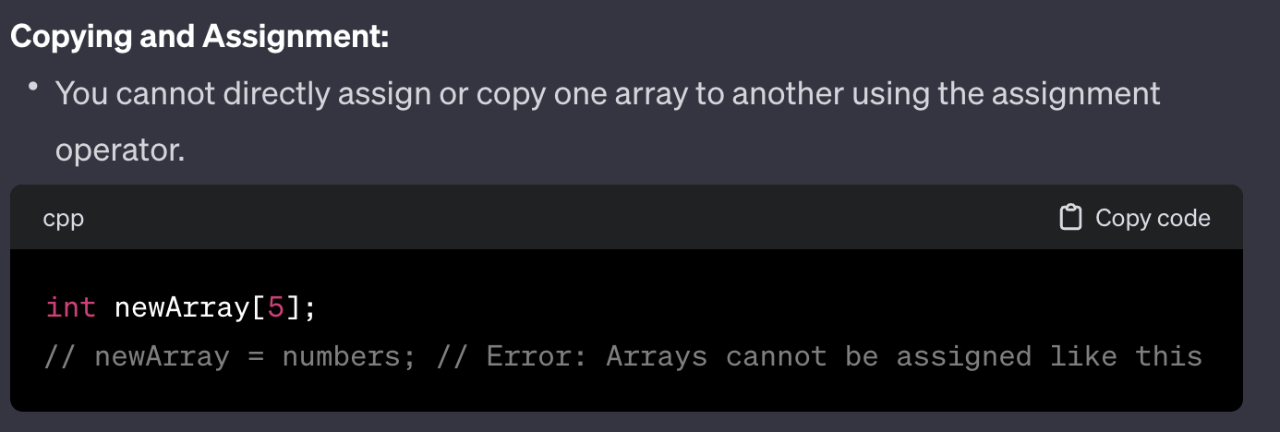
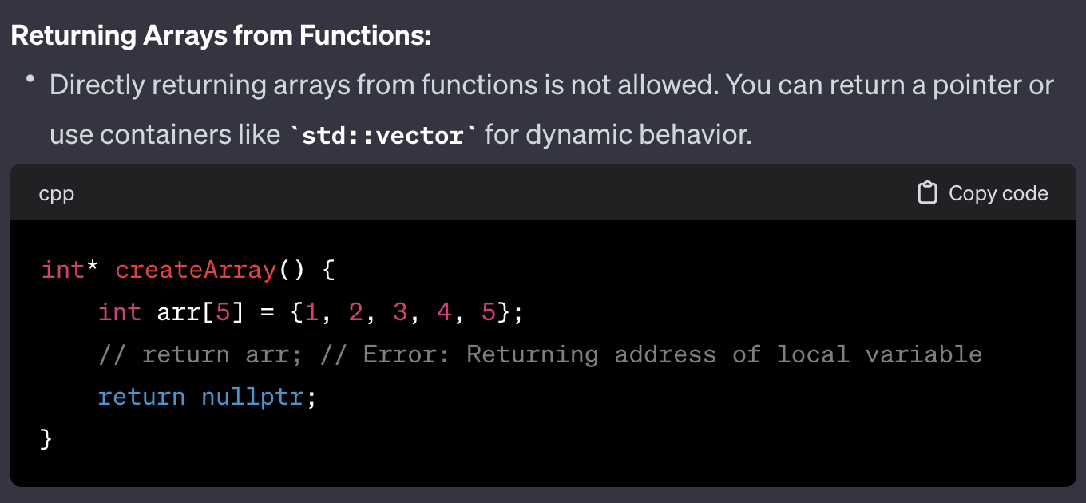
ARRAY
WHAT IS NOT ALLOWED?

Slide 40
Array Iteration
Unit-01.3.1

Slide 41
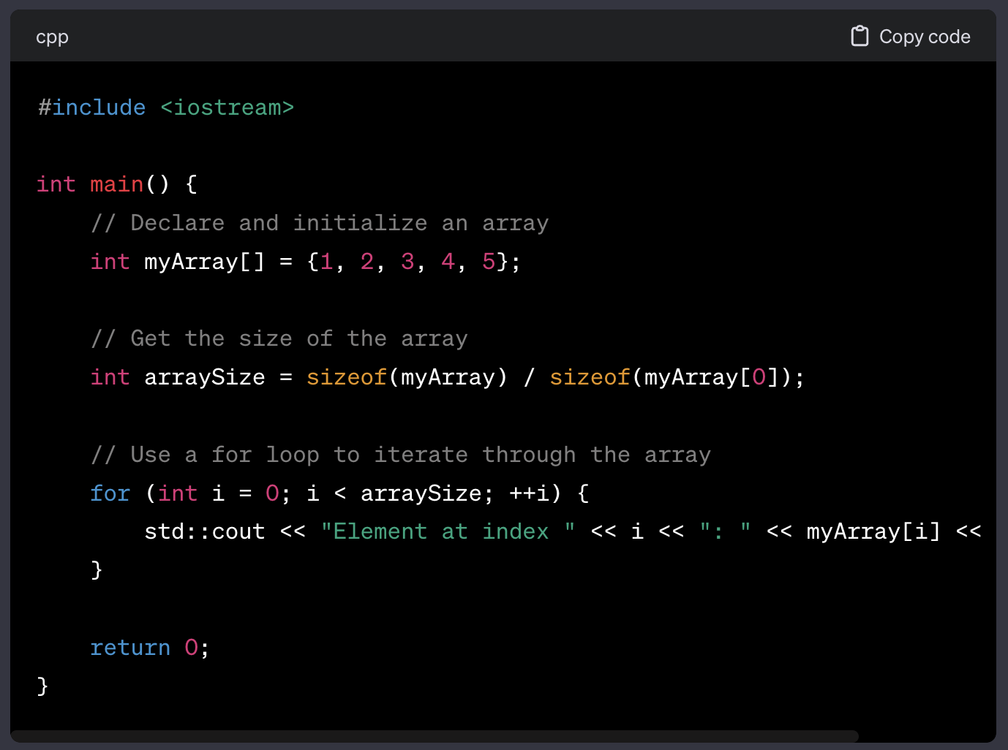
1428 BASED
Array Iteration 1428 Based

Slide 42
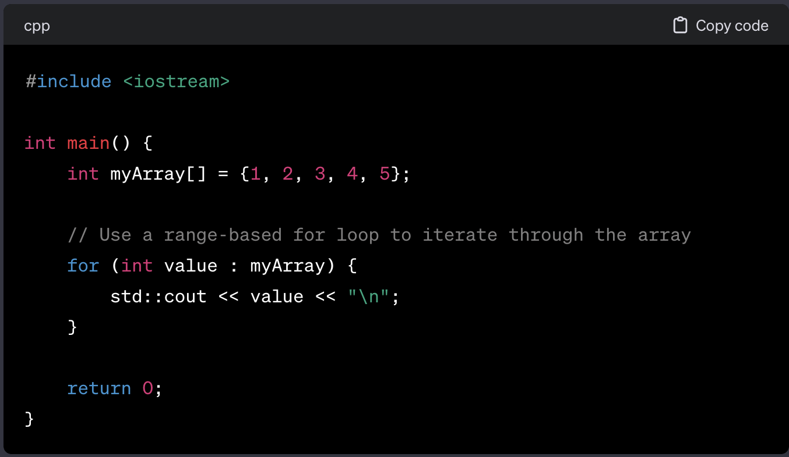
Array Iteration Range Based
RANGE BASED

Slide 43
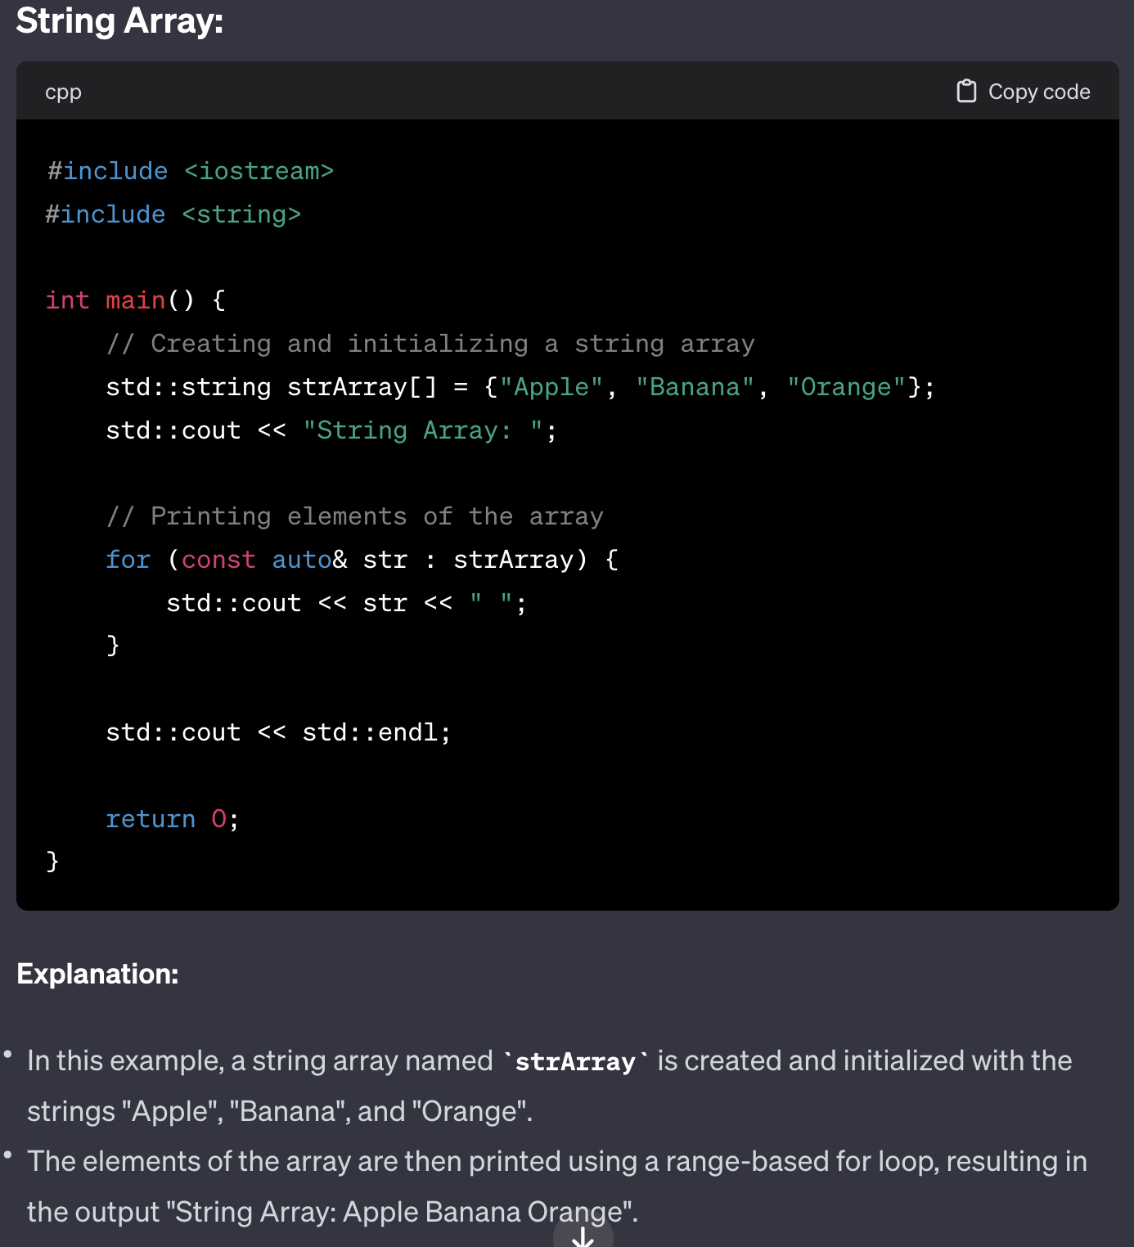
ARRAY
String Array
string

Slide 44

ARRAY
String Array

Slide 45

ARRAY
String Array

Slide 46
ARRAY
String Array
Use of Reference: Range based loops creates a copy of the element for each iteration. Unless you actually need a copy, there is no need to perform it. And if the objects you are copying are any larger than a built-in type (integer, pointer etc.), there is a potential performance penalty.
Ref: https://blog.knatten.org/2013/10/13/prefer-using-references-with-range-based-for-loops/

Slide 47
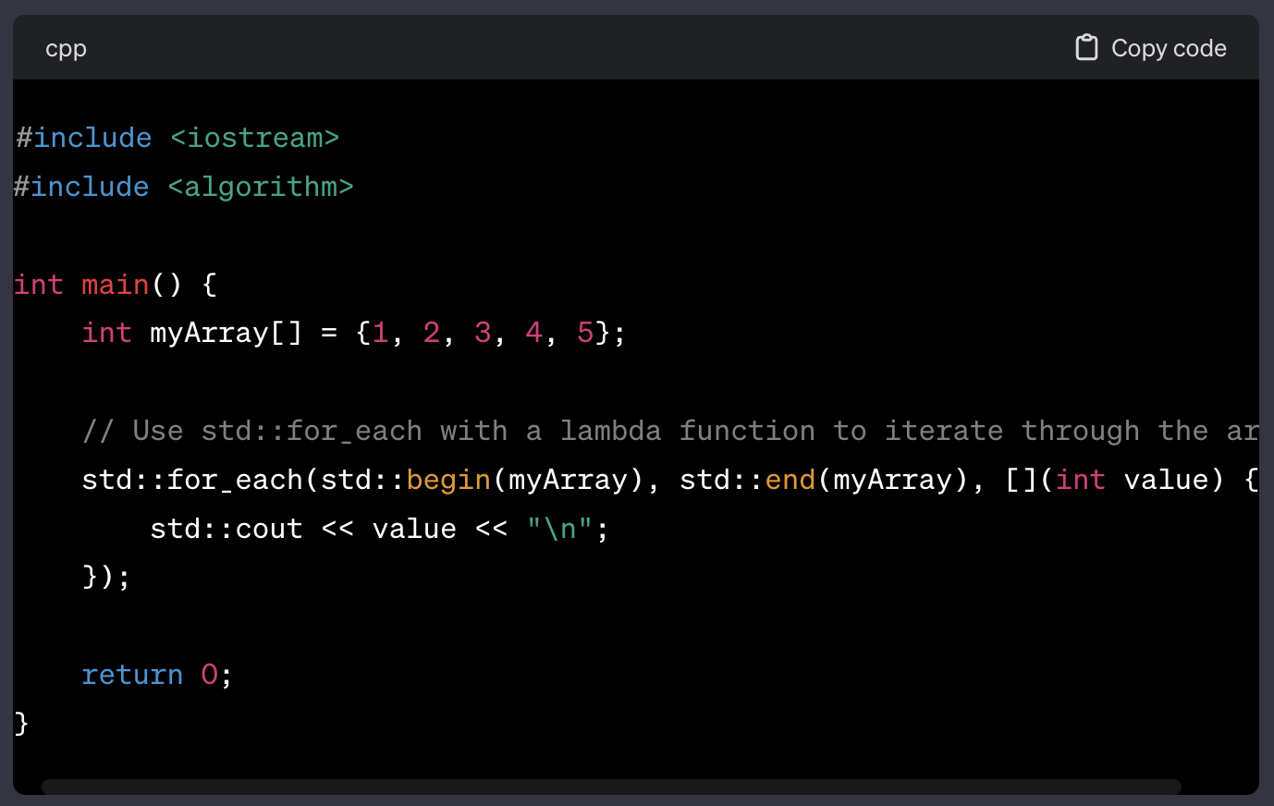
Array Iteration for_each Based
FOR_EACH
//signature
for_each(
begin_of_array,
end_of_array,
lambda_function
)

Slide 48
VECTORS
Unit-01.4

Slide 49


Slide 50


Slide 51


Slide 52

my
my
my

Slide 53



Slide 54


Slide 55


Slide 56


Slide 57
LIST
Unit-01.5

Slide 58


Slide 59


Slide 60


Slide 61


Slide 62


Slide 63


Slide 64


Slide 65


Slide 66
STACK
Unit-01.6

Slide 67


Slide 68


Slide 69


Slide 71


Slide 72


Slide 73
COMPARISONS
Unit-01.7

Slide 74


Slide 75
MAP
Unit-01.8

Slide 76



MAP

